Slide 1
Developing reciprocity between adults and young people in the research process
Dr Niamh O’Brien
Senior Research Fellow
Faculty of Health Social Care and Education
Anglia Ruskin University
Chelmsford
Twitter: @NiamhOB2
A Child’s World Conference
Aberystwyth University
11-13 July 2018

Slide 2
Presentation format
Context of the study
Participation in research
Extending a model of participation

Slide 3
School context
Based in the East of England: The Olive Tree School
Large school educating children from reception to sixth form
This study was located in the senior school
Both boarding and day school provision for boys and girls.

Slide 4
Overall Research Question
What do young people in this independent day and boarding school view as the core issue of bullying in the school and how do they want to address this?

Slide 5
Participation
What constitutes ‘participation’ by young
people is interpreted in many different ways
and often the degree to which they are
enabled to participate depends largely on
the attitude of adults around them and the
interpretation those adults place on
the term participation.

Slide 6
Models of Participation
Hart (1992) an eight-level ‘ladder participation’.
Shier’s (2001) ‘pathway to participation’
Chawla (2001) 7 forms of participation
Treseder (1997) wheel of participation
So participation can mean different things in different contexts and no one model or form can be applied across all settings and in all situations. Each model has its strengths and limitations and each may be appropriate for use in different contexts and situations.

Slide 7
Evaluating participation
Data on the process was collected at three points during the study
A series of questions were asked and supported by additional data
Built on an already existing model – The Dual Axis Model of Participation (Moules and O’Brien, 2012).

Slide 8
The Dual Axis Model of Participation (2012)
Recognises that participation is already happening.
Recognises the power differentials in the process
The model focuses on two dimensions of participation: ‘decision-making’ and ‘initiation and direction’.
Recognises that decision-making can either rest with adults, young people or it can be shared

Slide 9
The Dual Axis Model of Participation (2012)
The decision-making continuum
A Decision-making lies predominantly with the adults.
B Decision-making is shared.
C Decision-making lies predominantly with young people.
A
B
C
The initiation and direction continuum
A Initiation and direction lies predominantly with adults.
B Initiation and direction are shared.
C Initiation and direction lies predominantly with young people.
A
B
C

Slide 10
The Dual Axis Model of Participation (2012)

Slide 11
Extending the Dual Axis Model of Participation
Evaluation one: six months into the project:
A series of questions and young researchers were asked to ‘plot’ on a continuum their views

Slide 12
Extending the Dual Axis Model of Participation
The need to revisit what participation and involvement means
The sense of reciprocity – recognising that the young researchers needed a sense of belonging on the project.
Sometimes not all ideas turn into decisions

Slide 13
Extending the Dual Axis Model of Participation – ‘ideas’
Following on from evaluation one – ‘ideas’ was explored in evaluation two.
Approximately 18 months after the project started.

Slide 14
Extending the Dual Axis Model of Participation – ‘ideas’
The decision-making continuum
A Decision-making lies predominantly with the adults.
B Decision-making is shared.
C Decision-making lies predominantly with young people
A
B
C
The control and direction continuum
A Control and direction are determined by adults.
B Control and direction are shared.
C Control and direction are determined by young people
A
B
C
The ideas continuum
A Ideas are generated by adults.
B Ideas are generated together.
C Ideas are generated by young people
A
B
C

Slide 15
Extending the Dual Axis Model of Participation – ‘ideas’

Slide 16
Extending the Dual Axis Model of Participation – ‘ideas’
Quadrant | Activity
Quadrant A | Adults control/direct the activity and make the decisions.
Quadrant B | Young researchers have the ideas and they control/direct the activity while adults make the decisions | Quadrant B1 | Young Researchers have the ideas while adults make the decisions
 |  | Quadrant B2 | Young Researchers have the ideas and they control/direct the activity
Quadrant C | Adults have the ideas and they control/direct the activity while young researchers make the decisions | Quadrant C1 | Adults have the ideas and they control/direct the activity
 |  | Quadrant C2 | Adults have the ideas while young researchers make the decisions
Quadrant D | Young researchers control/direct the activity and make the decisions. They may require support from adults.
Shared | Decision-making, ideas and control/direction are shared between the young researchers and the adult
Notes:
Will need o flick back to previous slide

Slide 17
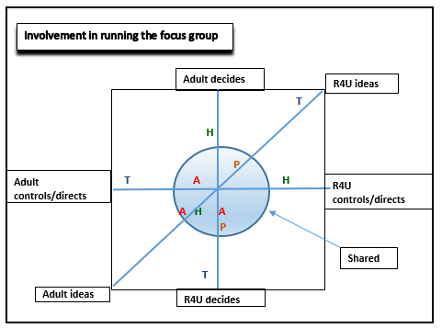
Extending the Dual Axis Model of Participation – ‘ideas’

Slide 18
R4U interpretations
“I felt I had an equal influence throughout all parts.” (Taha)
“Since I’ve been at every meeting, I understand nearly all the aspects” (Hanik)
“…how data was arranged and the focus groups and expressing my opinions” (Hope)
“The focus group and the analysis” (Amy)

Slide 19
Extending the Dual Axis Model of Participation – ‘ideas’
Participation was different for all team members
All members had a different agenda for involvement
A power shift occurred
Dialogue was encouraged which enabled change as the project evolved.

Slide 20
The adult role must not be forgotten
“….a research agenda dedicated to listening to children’s voices alone will not suffice to help us understand these processes which are as much about adults as they are about children.” (Mannion, 2007:414).

Slide 21
The adult role must not be forgotten

Slide 23
R4U critique
“I think its perfect – with the ethics though, I think that was more you telling us. More related to you than with us in terms of what you had to do” (Taha)
“I think the interviews weren’t entirely us but you as well” (Hanik)
“I agree with that but I also think the first focus group was half and half not just you” (Amy)

Slide 24
Working together (co-production)
“It’s like we’re a cricket team with 11 players and the coach. The coach helps and supports the team but the team plays the game. Everyone has to work together if you want to win the game. You’re like the coach and we’re like the team.” (Taha)

Slide 25
DMP – double extension
The decision-making continuum
A Decision-making lies predominantly with the adults.
B Decision-making is shared.
C Decision-making lies predominantly with young people
A
B
C
The control and direction continuum
A Control and direction are determined by adults.
B Control and direction are shared.
C Control and direction are determined by young people
A
B
C
The ideas continuum
A Ideas are generated by adults.
B Ideas generated together.
C Ideas are generated by young people
A
B
C
The knowledge continuum
A Adults have the knowledge.
B Knowledge is shared.
C Young people have the knowledge
A
B
C

Slide 26
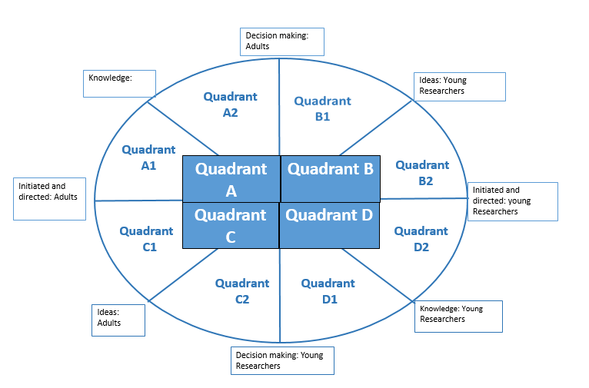
DMP – double extension

Slide 27
DMP – double extension
Quadrant | Activity
Quadrant A | Adults are the experts who initiate the activity and make the decisions | Quadrant A1 | Adults initiate the activity and adults are viewed as the experts
 |  | Quadrant A2 | Adults are viewed as the expert and adults make the decisions
Quadrant B | Young researchers have the ideas and they initiate the activity while adults make the decisions | Quadrant B1 | Young Researchers have the ideas while adults make the decisions
 |  | Quadrant B2 | Young Researchers have the ideas and they initiate the activity
Quadrant C | Adults have the ideas and they initiate the activity while young researchers make the decisions | Quadrant C1 | Adults have the ideas and they initiate the activity
 |  | Quadrant C2 | Adults have the ideas while young researchers make the decisions
Quadrant D | Young researchers are the experts who initiate the activity and make the decisions | Quadrant D1 | Young researchers are viewed as the experts and they make the decisions
 |  | Quadrant D2 | Young researchers initiate the activity and they are viewed as the experts

Slide 28
References
Mannion, G., 2007. Going Spatial, Going Relational: Why ‘‘listening to children’’ and children’s participation needs reframing. Discourse: studies in the cultural politics of education, 28(3), pp. 405-420.
Moules, T., and O'Brien, N., 2012. Participation in perspective: reflections from research projects. Nurse Researcher, 19(2), pp.17-22.
O’Brien, N., Moules, T., and Munn-Giddings, C. 2018. Negotiating the research space between young people and adults in a PAR study exploring school bullying. In M. Torronen., C. Munn-Giddings, C., and L. Tarkiainen (eds), Reciprocal Relationships and Well-Being: Implications for Social Work and Social Policy. Oxon: Routledge. Pp. 160-175.
O’Brien, N., Munn-Giddings, C. and Moules, T., 2018. The repercussions of reporting bullying: some experiences of students at an independent secondary school. Pastoral Care in Education, pp.1-15.

Slide 29
Contact details
Dr Niamh O’Brien
Senior Research Fellow
Faculty of Health Social Care and Education
Anglia Ruskin University
Chelmsford
CM3 3DJ
Email: Niamh.obrien@anglia.ac.uk
Phone: 0044 (0) 1245 684197
Twitter: @NiamhOB2

