Slide 1
Using Participatory Action Research to explore bullying with young people
Dr Niamh O’Brien
Senior Research Fellow
Faculty of Health Social Care and Education
Anglia Ruskin University
Chelmsford
Twitter: @NiamhOB2
Presentation to the National Anti Bullying Centre
Dublin City University
24th May 2018

Slide 2
Presentation format
Why involve young people in research
Example from two research projects: young people as commissioners and young people as co-researchers.
Using the ‘axis model of participation’.
Some ‘hands-on’ examples of research training.

Slide 3
Why involve young people in research
Children and young people are social actors with valuable contributions to make – New Sociology of Childhood.
Article 12 – UNCRC – Children have a right to be consulted in all areas affecting their lives.
UK developments – most recently Positive for youth: a new approach to cross government policy for young people aged 13-19 (DfE, 2011).
“…..if we support young people and give them the appropriate tools, they can innovate, they can collaborate and they can have an impact.”

Slide 4
Young People and Research
Young people as commissioners –PEAR project
Young people as co-researchers – Exploring bullying at their school
Young people as data sources – Young people who self-exclude from school due to severe bullying

Slide 5
Exploring bullying in a private day and boarding school
Co-Producing knowledge with young people through Participatory Action Research (PAR)

Slide 6
School context
Based in the East of England: The Olive Tree School
Large school educating children from reception to sixth form
This study was located in the senior school
Both boarding and day school provision for boys and girls.

Slide 7
Methodology
Participatory Action Research (PAR) framework rooted in the philosophy of social constructionism.
Social constructionism: recognises that knowledge is formed through human relationships rather than individuals on their own (Burr, 2003; Gergen and Gergen, 2008).
PAR: “a participatory, democratic process concerned with developing practical knowing in the pursuit of worthwhile human purposes” (Reason and Bradbury, 2001:1)

Slide 8
Theoretical position
Social construction of bullying and it’s manifestation in groups (Horton, 2011; Schott & Sondergaard, 2014)
Bullying might be more usefully understood as:
“…a social phenomenon involving ordinary children in particular situations.” (Horton, 2011:269)”
To understand more about bullying as a social construct, there is a need to listen to young people and consider the context in which the bullying has occurred

Slide 9
Overall Research Question
What do young people in this independent day and boarding school view as the core issue of bullying in the school and how do they want to address this?

Slide 10
Research Design

Slide 11
How knowledge was co-produced
Data on the process was collected at three points during the study
A series of questions were asked and supported by additional data
Built on an already existing model – The Dual Axis Model of Participation (Moules and O’Brien, 2012).

Slide 12
The Dual Axis Model of Participation (2012)
Recognises that participation is already happening.
Recognises the power differentials in the process
The model focuses on two dimensions of participation: ‘decision-making’ and ‘initiation and direction’.
Recognises that decision-making can either rest with adults, young people or it can be shared

Slide 13
The Dual Axis Model of Participation (2012)
The decision-making continuum
A Decision-making lies predominantly with the adults.
B Decision-making is shared.
C Decision-making lies predominantly with young people.
A
B
C
The initiation and direction continuum
A Initiation and direction lies predominantly with adults.
B Initiation and direction are shared.
C Initiation and direction lies predominantly with young people.
A
B
C

Slide 14
The Dual Axis Model of Participation (2012)

Slide 15
Extending the Dual Axis Model of Participation
Evaluation one: six months into the project:
A series of questions and young researchers were asked to ‘plot’ on a continuum their views

Slide 16
Extending the Dual Axis Model of Participation
The need to revisit what participation and involvement means
The sense of reciprocity – recognising that the young researchers needed a sense of belonging on the project.
Sometimes not all ideas turn into decisions

Slide 17
Extending the Dual Axis Model of Participation – ‘ideas’
Following on from evaluation one – ‘ideas’ was explored in evaluation two.
Approximately 18 months after the project started.

Slide 18
Extending the Dual Axis Model of Participation – ‘ideas’
The decision-making continuum
A Decision-making lies predominantly with the adults.
B Decision-making is shared.
C Decision-making lies predominantly with young people
A
B
C
The control and direction continuum
A Control and direction are determined by adults.
B Control and direction are shared.
C Control and direction are determined by young people
A
B
C
The ideas continuum
A Ideas are generated by adults.
B Ideas are generated together.
C Ideas are generated by young people
A
B
C

Slide 19
Extending the Dual Axis Model of Participation – ‘ideas’

Slide 20
Extending the Dual Axis Model of Participation – ‘ideas’
Quadrant | Activity
Quadrant A | Adults control/direct the activity and make the decisions.
Quadrant B | Young researchers have the ideas and they control/direct the activity while adults make the decisions | Quadrant B1 | Young Researchers have the ideas while adults make the decisions
 |  | Quadrant B2 | Young Researchers have the ideas and they control/direct the activity
Quadrant C | Adults have the ideas and they control/direct the activity while young researchers make the decisions | Quadrant C1 | Adults have the ideas and they control/direct the activity
 |  | Quadrant C2 | Adults have the ideas while young researchers make the decisions
Quadrant D | Young researchers control/direct the activity and make the decisions. They may require support from adults.
Shared | Decision-making, ideas and control/direction are shared between the young researchers and the adult

Slide 21
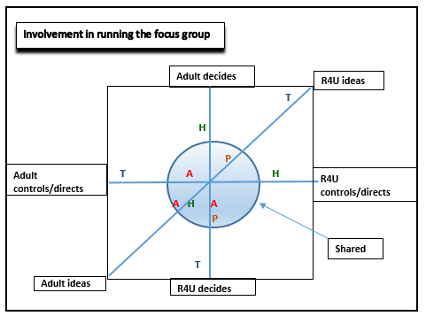
Extending the Dual Axis Model of Participation – ‘ideas’

Slide 22
R4U interpretations
“I felt I had an equal influence throughout all parts.” (Taha)
“Since I’ve been at every meeting, I understand nearly all the aspects” (Hanik)
“…how data was arranged and the focus groups and expressing my opinions” (Hope)
“The focus group and the analysis” (Amy)

Slide 23
Extending the Dual Axis Model of Participation – ‘ideas’
Participation was different for all team members
All members had a different agenda for involvement
A power shift occurred
Dialogue was encouraged which enabled change as the project evolved.

Slide 24
The adult role must not be forgotten
“….a research agenda dedicated to listening to children’s voices alone will not suffice to help us understand these processes which are as much about adults as they are about children.” (Mannion, 2007:414).

Slide 25
The adult role must not be forgotten

Slide 27
R4U critique
“I think its perfect – with the ethics though, I think that was more you telling us. More related to you than with us in terms of what you had to do” (Taha)
“I think the interviews weren’t entirely us but you as well” (Hanik)
“I agree with that but I also think the first focus group was half and half not just you” (Amy)

Slide 28
Working together (co-production)
“It’s like we’re a cricket team with 11 players and the coach. The coach helps and supports the team but the team plays the game. Everyone has to work together if you want to win the game. You’re like the coach and we’re like the team.” (Taha)

Slide 29
DMP – double extension
The decision-making continuum
A Decision-making lies predominantly with the adults.
B Decision-making is shared.
C Decision-making lies predominantly with young people
A
B
C
The control and direction continuum
A Control and direction are determined by adults.
B Control and direction are shared.
C Control and direction are determined by young people
A
B
C
The ideas continuum
A Ideas are generated by adults.
B Ideas generated together.
C Ideas are generated by young people
A
B
C
The knowledge continuum
A Adults have the knowledge.
B Knowledge is shared.
C Young people have the knowledge
A
B
C

Slide 30
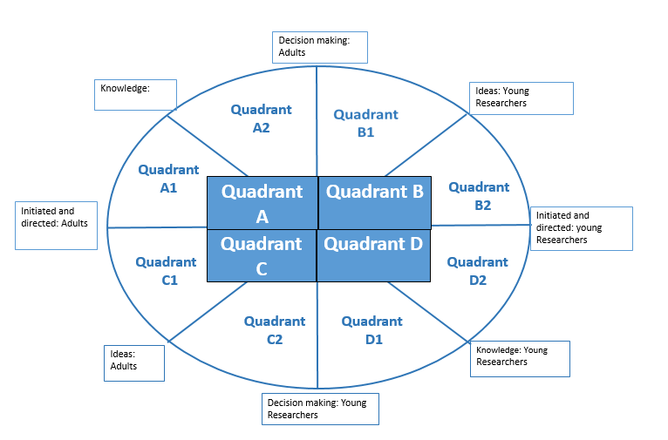
DMP – double extension

Slide 31
DMP – double extension
Quadrant | Activity
Quadrant A | Adults are the experts who initiate the activity and make the decisions | Quadrant A1 | Adults initiate the activity and adults are viewed as the experts
 |  | Quadrant A2 | Adults are viewed as the expert and adults make the decisions
Quadrant B | Young researchers have the ideas and they initiate the activity while adults make the decisions | Quadrant B1 | Young Researchers have the ideas while adults make the decisions
 |  | Quadrant B2 | Young Researchers have the ideas and they initiate the activity
Quadrant C | Adults have the ideas and they initiate the activity while young researchers make the decisions | Quadrant C1 | Adults have the ideas and they initiate the activity
 |  | Quadrant C2 | Adults have the ideas while young researchers make the decisions
Quadrant D | Young researchers are the experts who initiate the activity and make the decisions | Quadrant D1 | Young researchers are viewed as the experts and they make the decisions
 |  | Quadrant D2 | Young researchers initiate the activity and they are viewed as the experts

Slide 32
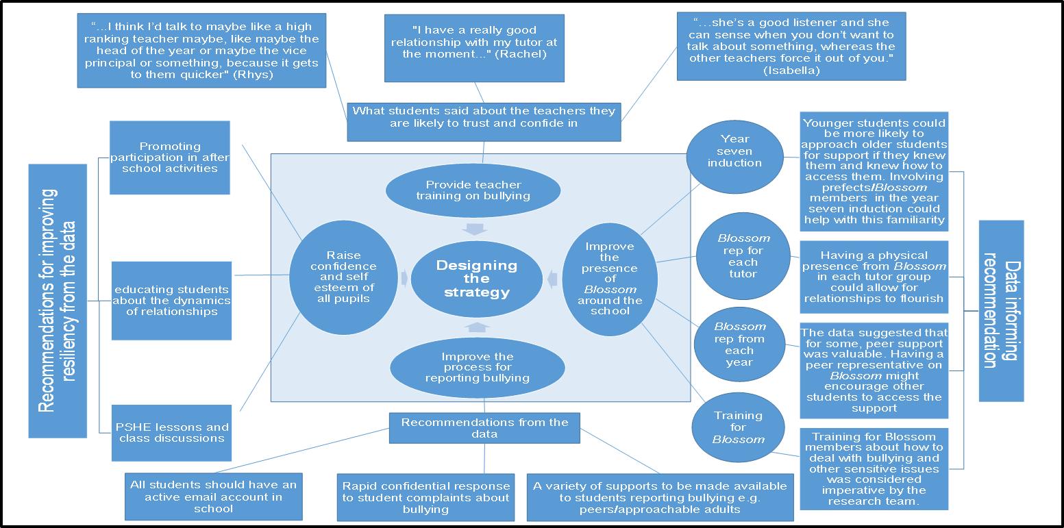
Co-Produced Anti-Bullying Strategy

Slide 33
Outcomes as reported by young people themselves
The only people who can tell you what it’s like to be a child or young person is us so listen to what we have to say.” (R.TYP).
“We have learnt lots of new skills—not only research skills and data collection methods but understanding that everybody can join in even if they have a disability.” (R.TYP)
“We were given lots of opportunities to give our input but sometimes we chose not to because we didn‟t have the time. (PEAR)
“I’ve learnt a lot about research. I’ve also learnt to respect researchers and the work they do. It’s so difficult to get people to participate in things like questionnaires” (R4U)

Slide 34
Some ‘hands-on’ examples from our training

Slide 35
References
Burr, V., 2003. Social Constructionism, 2nd ed. London: Routledge.
Gergen, K.J., and Gergen, M.M., 2008. Social Construction and Research as Action. In: P. Reason, and H. Bradbury, 2nd ed. The Sage Handbook of Action Research: Participative Inquiry and Practice. London: Sage, pp.159-171
Horton, P., 2011. School Bullying and Social and Moral Orders. Children and Society, 25, pp. 268-277.
Mannion, G., 2007. Going Spatial, Going Relational: Why ‘‘listening to children’’ and children’s participation needs reframing. Discourse: studies in the cultural politics of education, 28(3), pp. 405-420.
Moules, T., and O'Brien, N., 2012. Participation in perspective: reflections from research projects. Nurse Researcher, 19(2), pp.17-22.
O’Brien, N., Moules, T., and Munn-Giddings, C. 2018. Negotiating the research space between young people and adults in a PAR study exploring school bullying. In M. Torronen., C. Munn-Giddings, C., and L. Tarkiainen (eds), Reciprocal Relationships and Well-Being: Implications for Social Work and Social Policy. Oxon: Routledge. Pp. 160-175.
O’Brien, N., Munn-Giddings, C. and Moules, T., 2018. The repercussions of reporting bullying: some experiences of students at an independent secondary school. Pastoral Care in Education, pp.1-15.
Reason, P., and Bradbury, H., 2008. Concluding Reflections: Whither Action Research? In: P. Reason, and H. Bradbury, eds. The Sage Handbook of Action Research: Participative Inquiry and Practice. 2nd ed. Thousand Oaks, CA: Sage, pp. 695-707.
Schott, R.M and Sondergaard, D.M. 2014. Introduction: new approaches to school bullying. In R.M. Schott, and D.M. Sondergaard, eds, School Bullying: New Theories in Context, Massachusetts: Cambridge University Press, pp. 1-17.

Slide 36
Contact details
Dr Niamh O’Brien
Senior Research Fellow
Faculty of Health Social Care and Education
Anglia Ruskin University
Chelmsford
CM3 3DJ
Email: Niamh.obrien@anglia.ac.uk
Phone: 0044 (0) 1245 684197
Twitter: @NiamhOB2
Notes:
Truth
Ethics
Analysis

