Slide 1
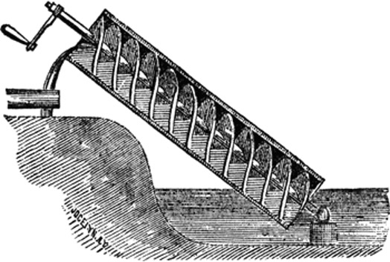
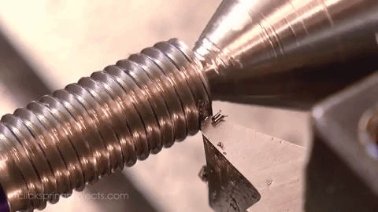
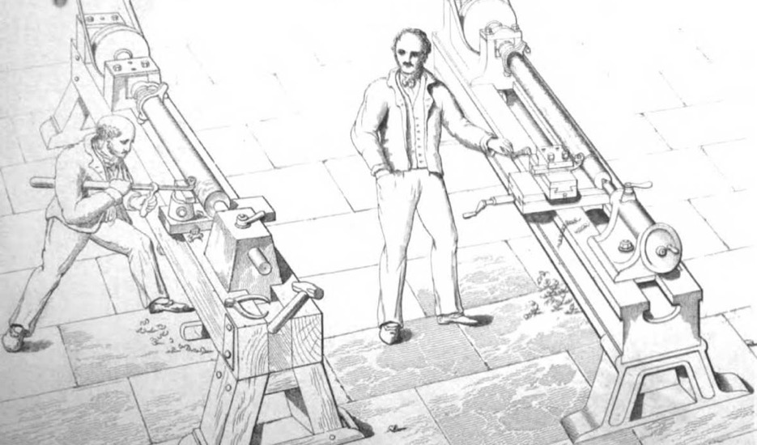
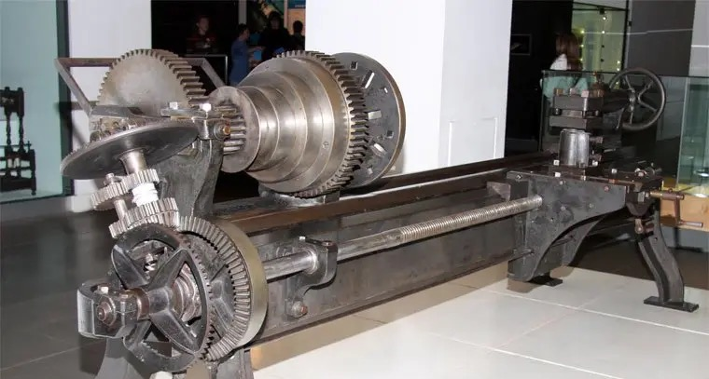
The Screw

Slide 2
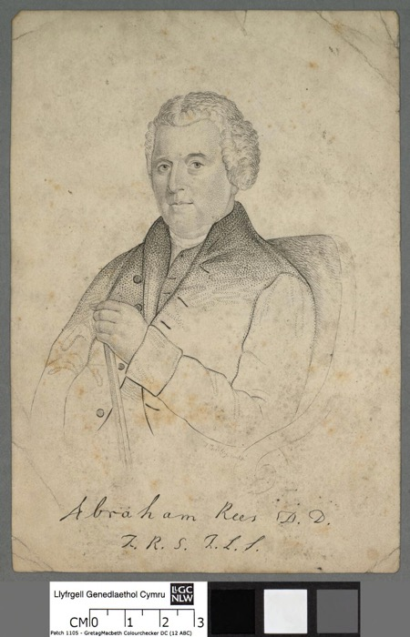
‘Machine, in a general sense, signifies any thing that is used to augment or to regulate moving forces or powers; or, it is any instrument employed to produce motion, so as to save either time or force. The word is derived from [Greek for machine], machine, invention, art; and is therefore properly applied to any agent in which these are combined. (Abraham Rees, ’Machine’, Manufacturing Industry, (1819-20)
Of the Six Simple Machines Rees writes, 'Screws are, of all the mechanical powers, the most frequently used in machines'.

Slide 3
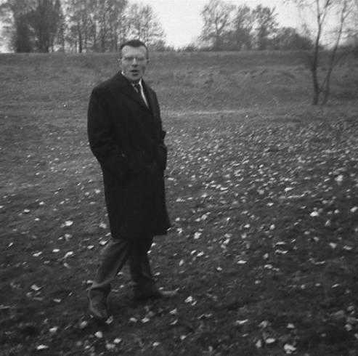
[The machine] is the stranger inside which something human is locked up’ (Gilbert Simondon On the Mode of Existence of Technical Objects, 1957).
‘Culture behaves toward the technical object as a man to a stranger […] carried away by a primitive xenophobia’
‘the most powerful cause of alienation in the contemporary world resides in this misunderstanding of the machine, which is not an alienation caused by the machine, but by the non-knowledge of its nature and essence.’ (On the Mode of Existence of Technical Objects).

Slide 4
‘Those who style themselves as “solid materialists” have not given a second thought to the solidity of materials. I am perfectly happy for people to look down on religion – a device that has failed to maintain its ontological standing in the face of competition from the sciences; and I understand completely that people should mistrust the constant tinkering of psychology, which always threatens a rather dangerous contamination of that which it manipulates... but tools? automatons? machines? the very landscape that we have ceaselessly ploughed and tilled for hundreds of thousands of years, the inventions which, over the past three centuries, have upturned our lives far more radically than all of the other passions? For every thousand books published on the benefits of objective knowledge – and the dire risks we would be running were it called into question – there are barely ten on the importance of the technical – […] as for a “technologist” [technologue] we would only expect such a person to come round and repair the machine, not to teach us anything.’ (Bruno Latour, “Prendre le pli des techniques”, Réseaux 2010/5 no. 163, p 19 – 20

Slide 5
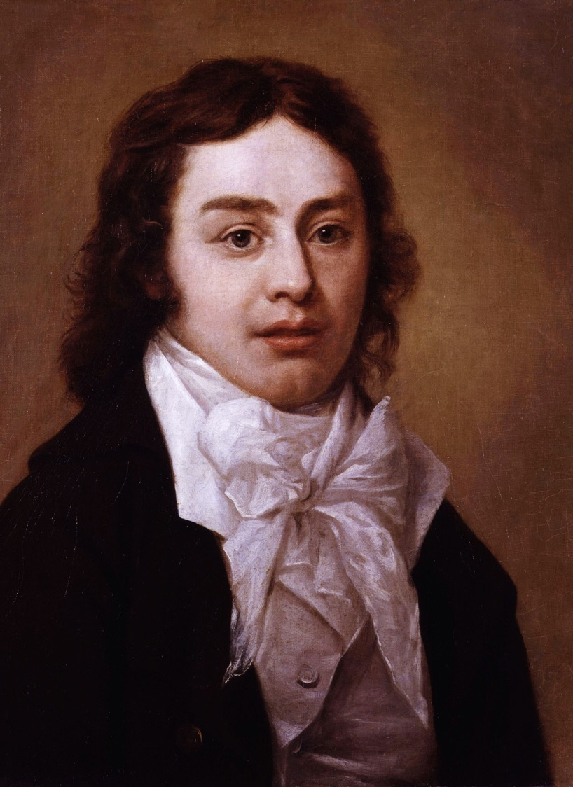
'The form is mechanic when on any given material we impress a predetermined form, not necessarily arising out of the properties of the material-as when to a mass of wet clay we give whatever shape we wish it to retain when hardened. The organic form, on the other hand, is innate; it shapes as it develops itself from within, and the fullness of its development is one and the same with the perfection of its outward form.'
S. T. Coleridge, 'Shakespeare, A Poet Generally’ Coleridge Lectures 1808-1819 on Literature)

Slide 6
‘[There] was no single, unified, or universally accepted method for measuring meter available during’ the nineteenth century. […] nineteenth-century poets and readers sometimes struggled to make sense of –not to mention agree on—matters of versification. According to Samuel Taylor Coleridge, for example, the young Alfred Tennyson had no “understanding” of meter, so ostensibly dissimilar were the two poets’ positions on the subject.’ Jason David Hall, Meter Matters: Verse Cultures of the Long Nineteenth Century (2011)

Slide 7
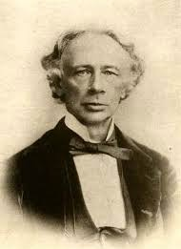
'the writings of Puttenham, Gascoigne, Campion , Webbe, Daniel, Crowe, Foster, Mitford, Guest, and others, it must be confessed that no one of these writers readers anything like a full and philosophical account of the subject […] George Puttenham's “Art of English Poesy"' is by very much the most bulky and laborious of the early metrical essays ; but at least nine-tenths of this book consist of as unprofitable writing as ever spoilt paper.’ (Coventry Patmore, ‘English Metrical Law’, 1857)

Slide 8
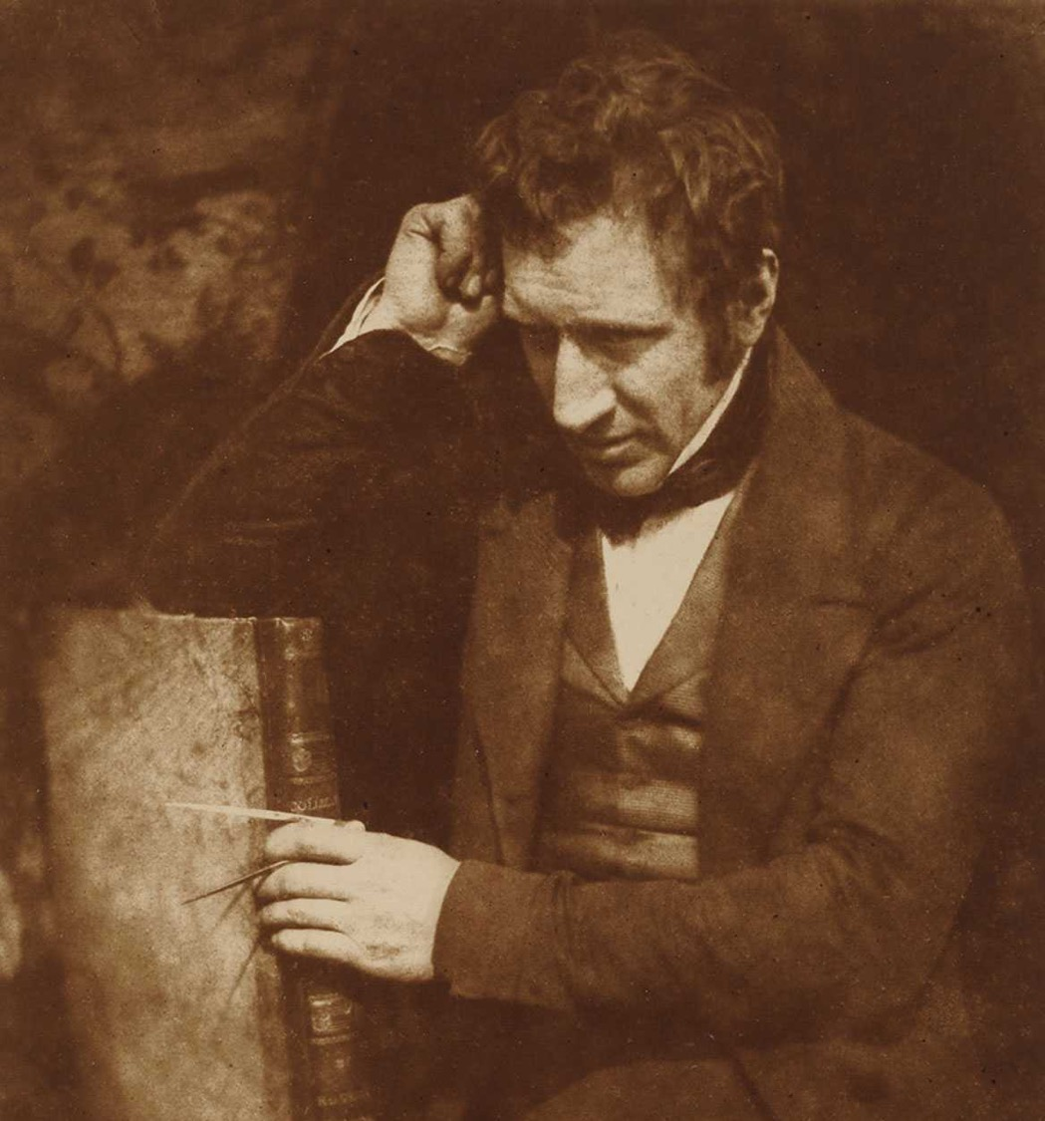
James Nasmyth: ‘No system was observed as to “pitch”, i.e., the number of threads to the inch, nor was any rule followed as to the form of these threads. Every bolt and nut was thus a speciality in itself, and neither possessed nor admitted any community with its neighbours. […] all bolts and their corresponding nuts had to be marked as belonging to each other; and any mixing of them together led to endless trouble, hopeless confusion, and enormous expense.’
James Nasmyth, Engineer: An Autobiography, ed. Samuel Smiles (London: John Murray, 1883), p. 131.

Slide 9
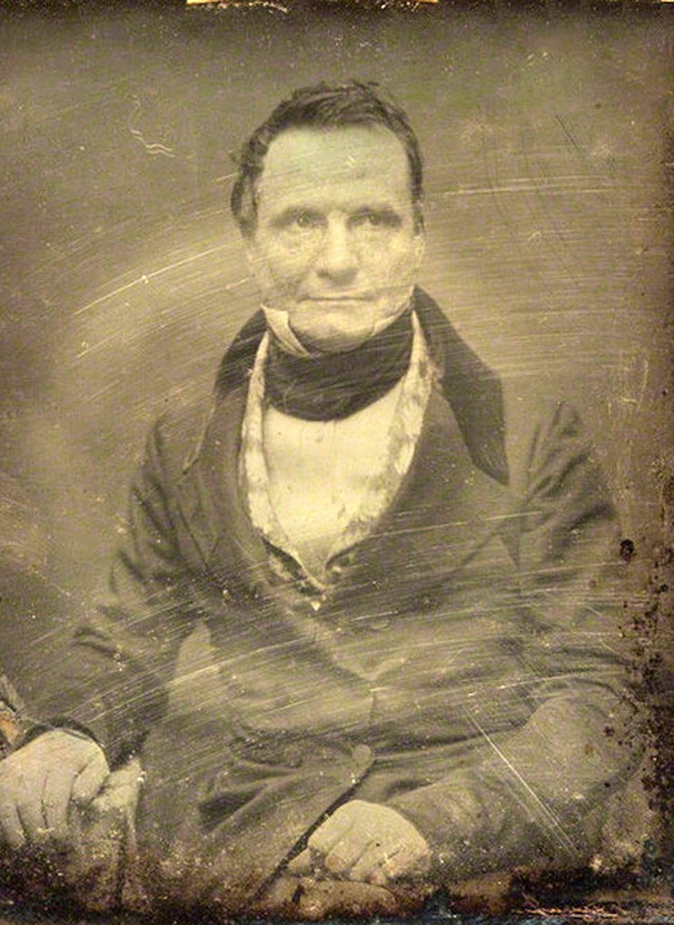
'Those who enjoy leisure can scarcely find a more interesting and instructive pursuit than the examination of the workshops of their own country, which contain within them a rich mine of knowledge, too generally neglected by the wealthier classes.' (Charles Babbage On the Economy of Machinery and Manufactures, 1832)

Slide 10
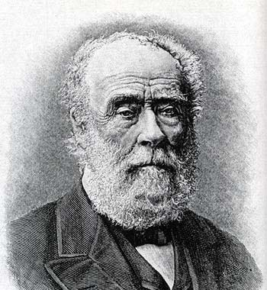
An extensive collection was made of screw bolts from the principal workshops throughout England, and the average thread was carefully observed for different diameters. […] The mean of the variations of this angle in one-inch screws was found to be about 55°, and […]has been latterly adopted throughout the entire scale.' (Joseph Whitworth, On a Uniform System of Screw Threads, 1841), 5.

Slide 11
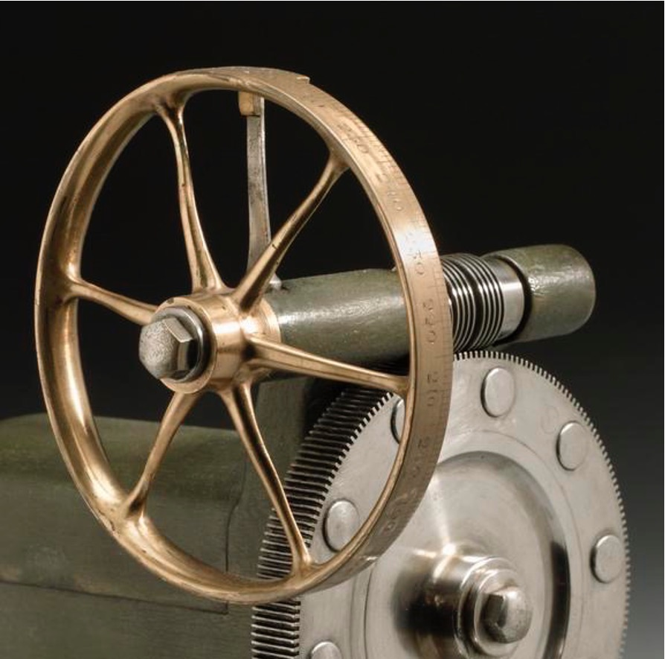
'The average pitch and depth of the various threads used by the leading engineers would thus become the common standard, which would not only have the advantage of conciliating general concurrence, but would, in all probability, be nearer the true standard for practical purposes than any other.' (Joseph Whitworth, On a Uniform System of Screw Threads, 1841)

Slide 12
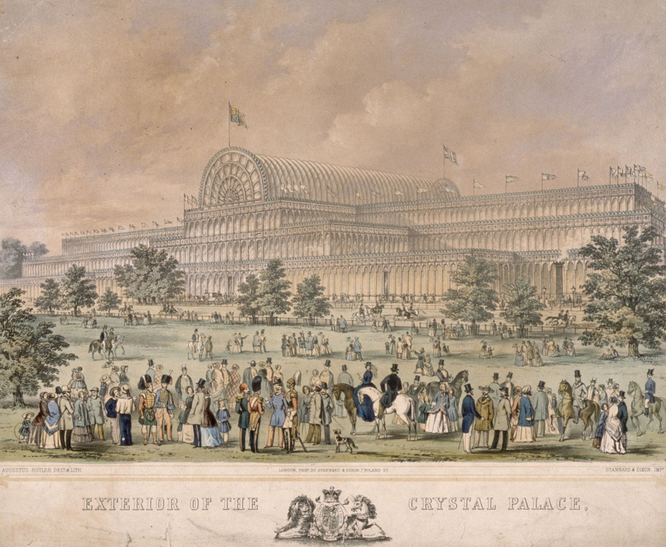

Slide 13
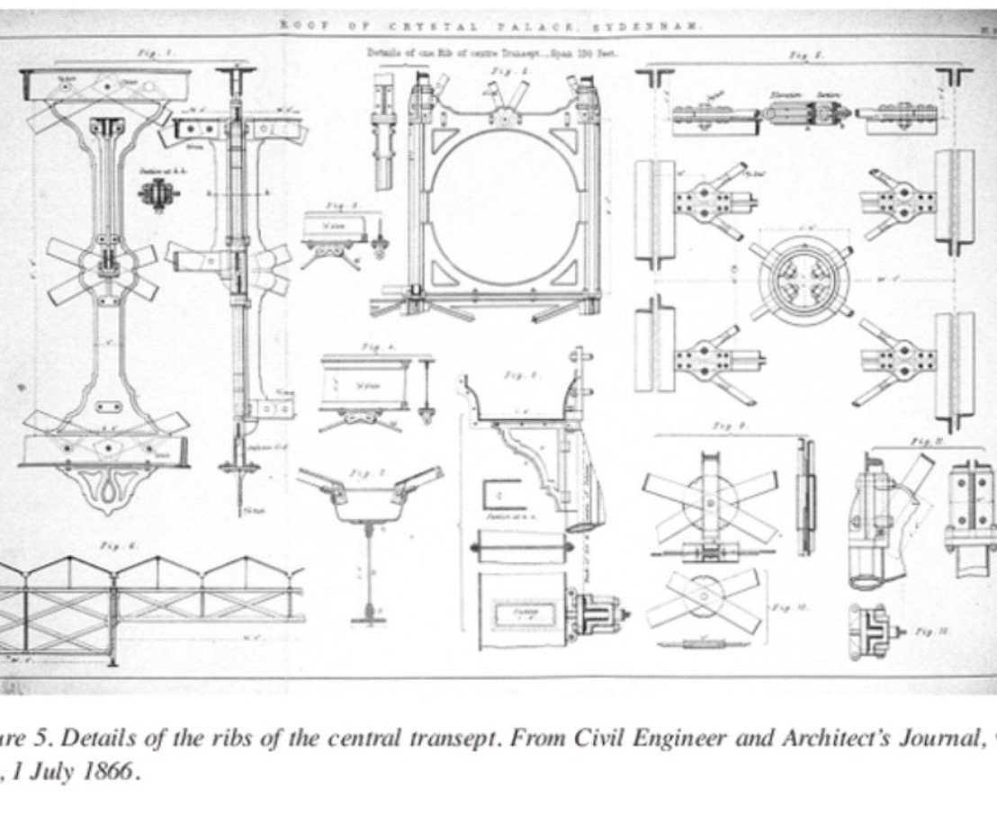

Slide 14
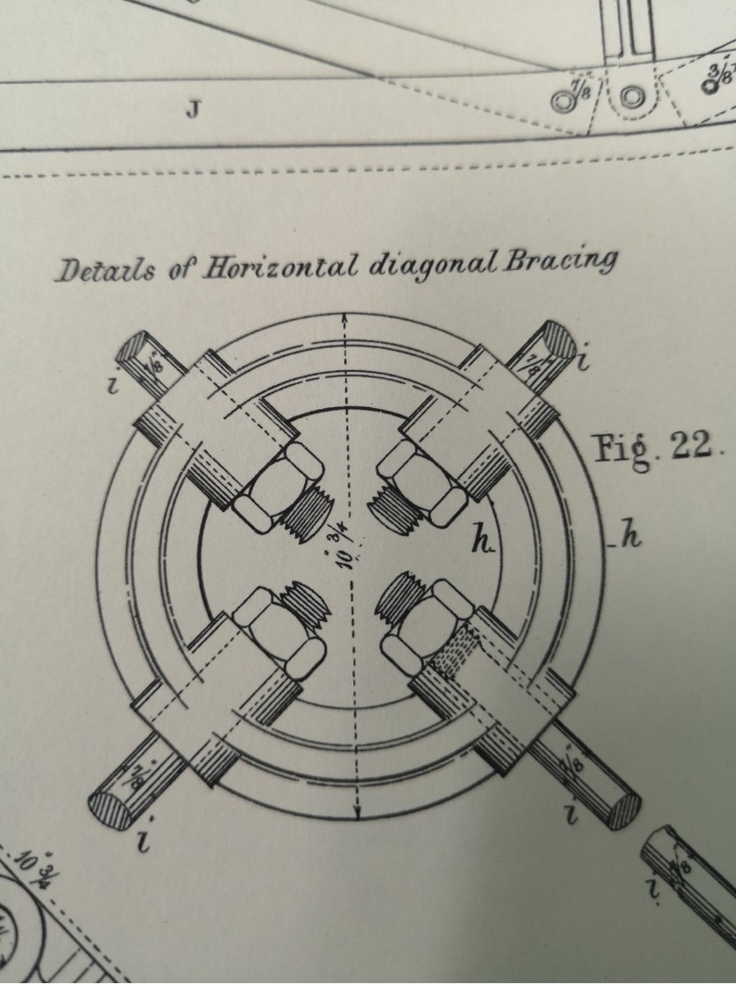

Slide 15
