Slide 1
The question with me is, whether I and all mankind are born slaves or free. That is the one thing necessary to know and make good [...] Secure this point, and all is safe: lose this and all is lost.’ (Preface to Political Essays, 1819).

Slide 2
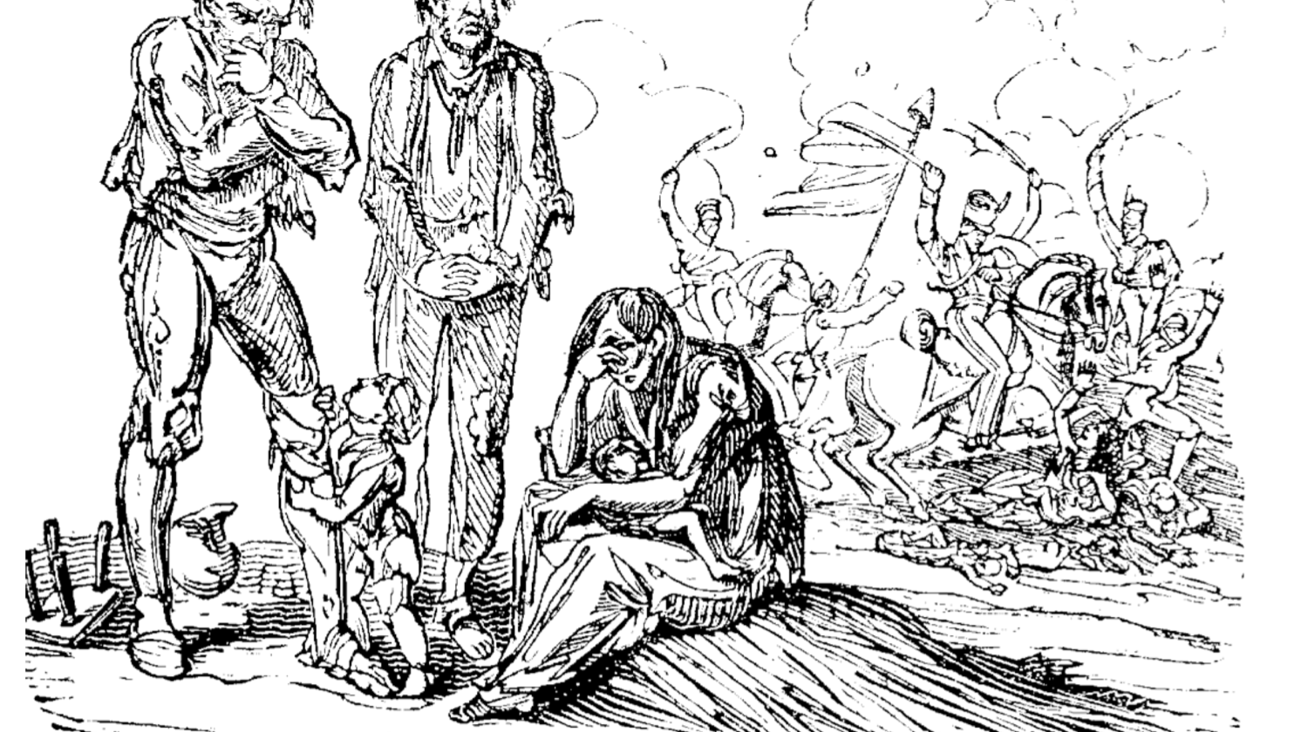
Hazlitt’s
Political Essays
and Peterloo
Two Questions:
What has Political Essays to do with Peterloo?
Why does Hazlitt subsequently say only one thing on Peterloo?
John.gardner@Anglia.ac.uk
‘[I] have a hatred of tyranny, and a contempt for its tools; and this feeling I have expressed as often and as strongly as I could. I cannot sit down quietly under the claims of bare-faced power, and I have tried to expose the little arts of sophistry by which they are defended.’ (Hazlitt, Preface to Political Essays, 1819).

Slide 3
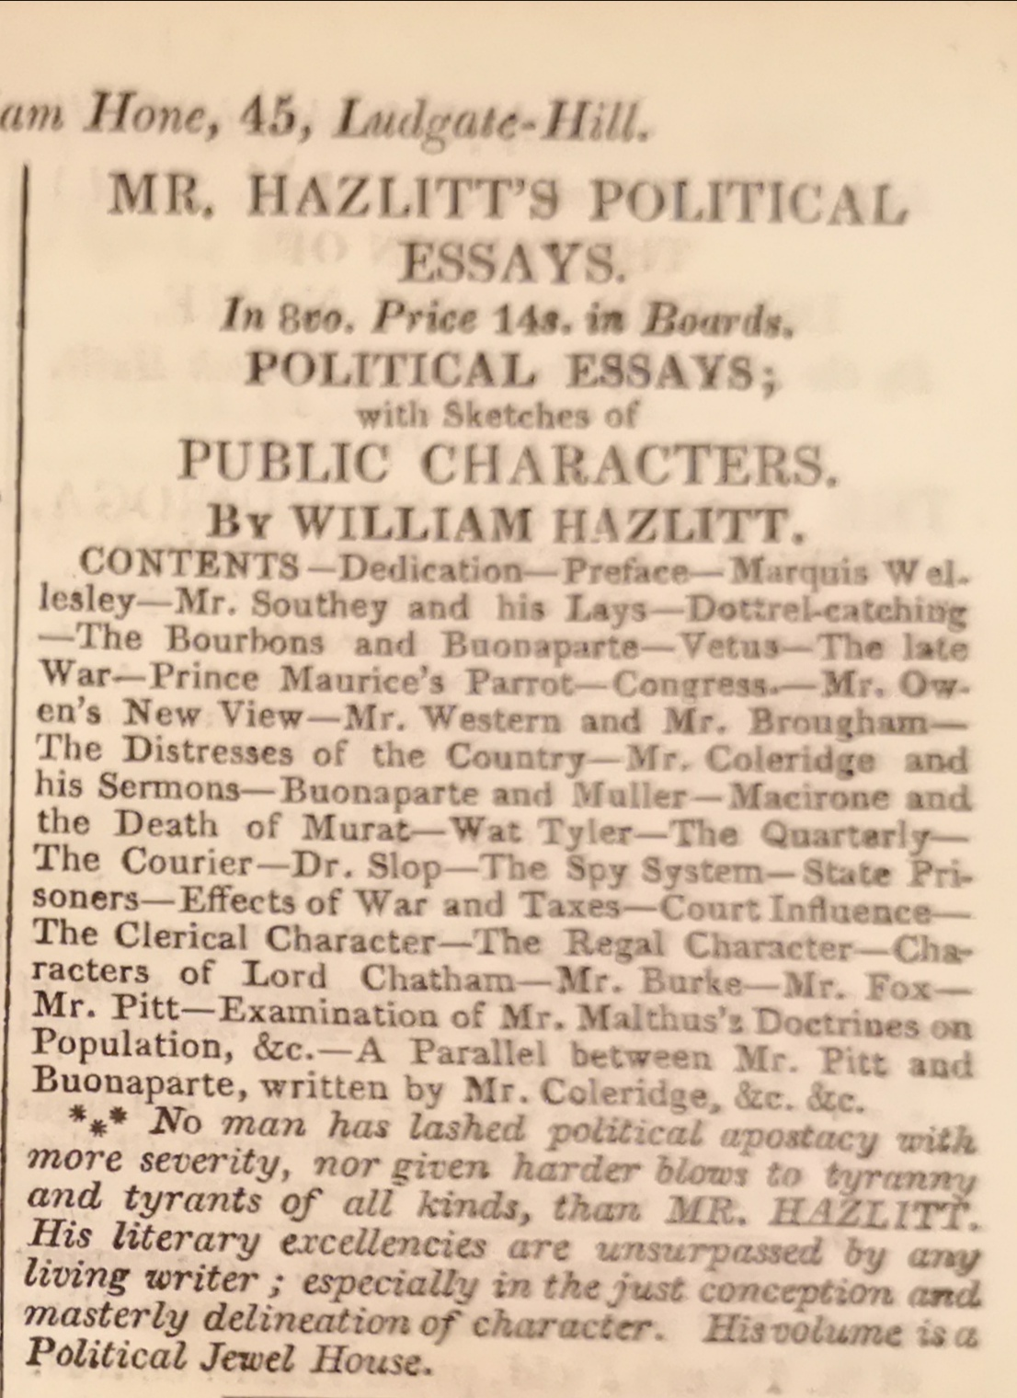

Slide 4
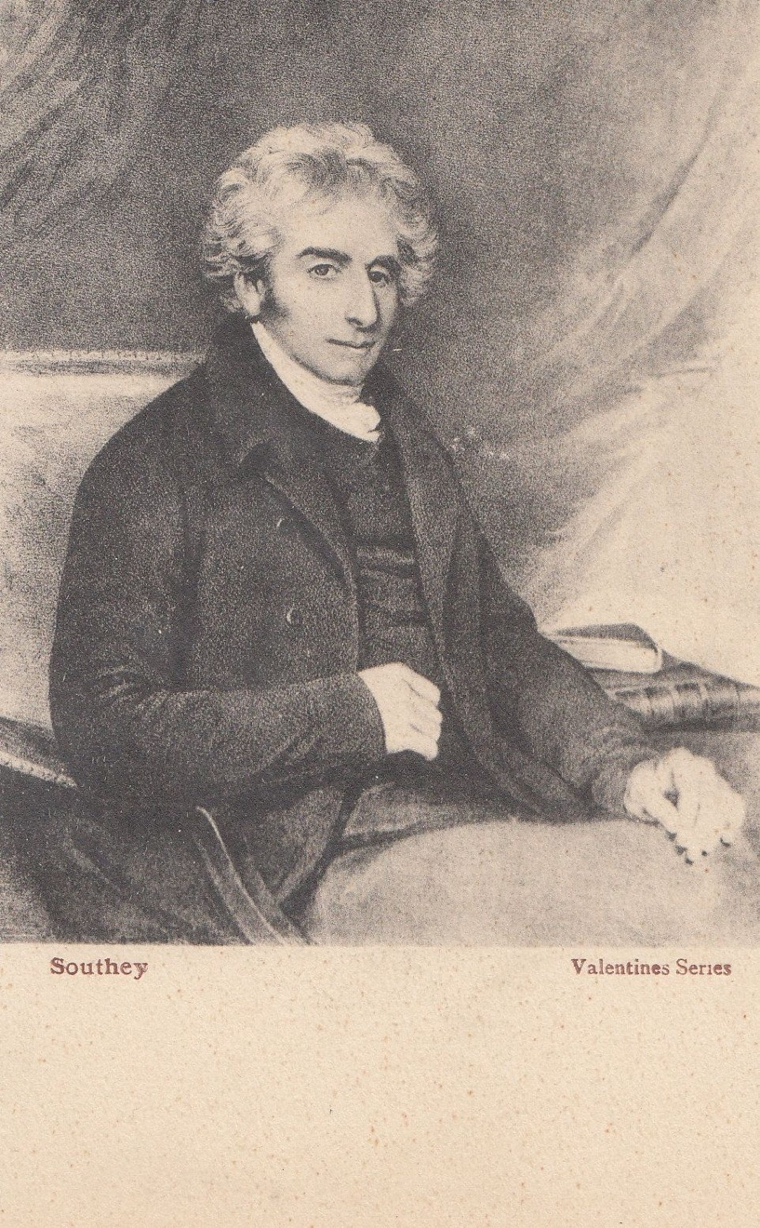

Slide 5
‘As for Hazlitt, it is not to be believed how the destruction of Napoleon affected him; he seemed prostrated in mind and body, he walked about, unwashed, unshaved, hardly sober by day, and always intoxicated by night, literally, without exaggeration, for weeks; until at length, wakening as it were from his stupor, he at once left off all stimulating liquors, and never touched them after.’
The Autobiography of B. R. Haydon, ed. By Tom Taylor with an introduction by Aldous Huxley, 3 vols (London: Peter Davies, 1926) I, 213.

Slide 6
For my part, I started in life with the French Revolution, and I have lived, alas! To see the end of it. But I did not foresee this result. My sun arose with the first dawn of liberty and I did not think how soon both must set. The new impulse to ardour given to men's minds imparted a congenial warmth and glow to mine; we were strong to run a race together, and I little dreamed that long before mine was set, the sun of liberty would turn to blood, or set once more in the night of despotism. Since then I confess, I have no longer felt myself young, for with that my hopes fell. (Hazlitt, ‘The Feeling of Immortality in Youth’)

Slide 8
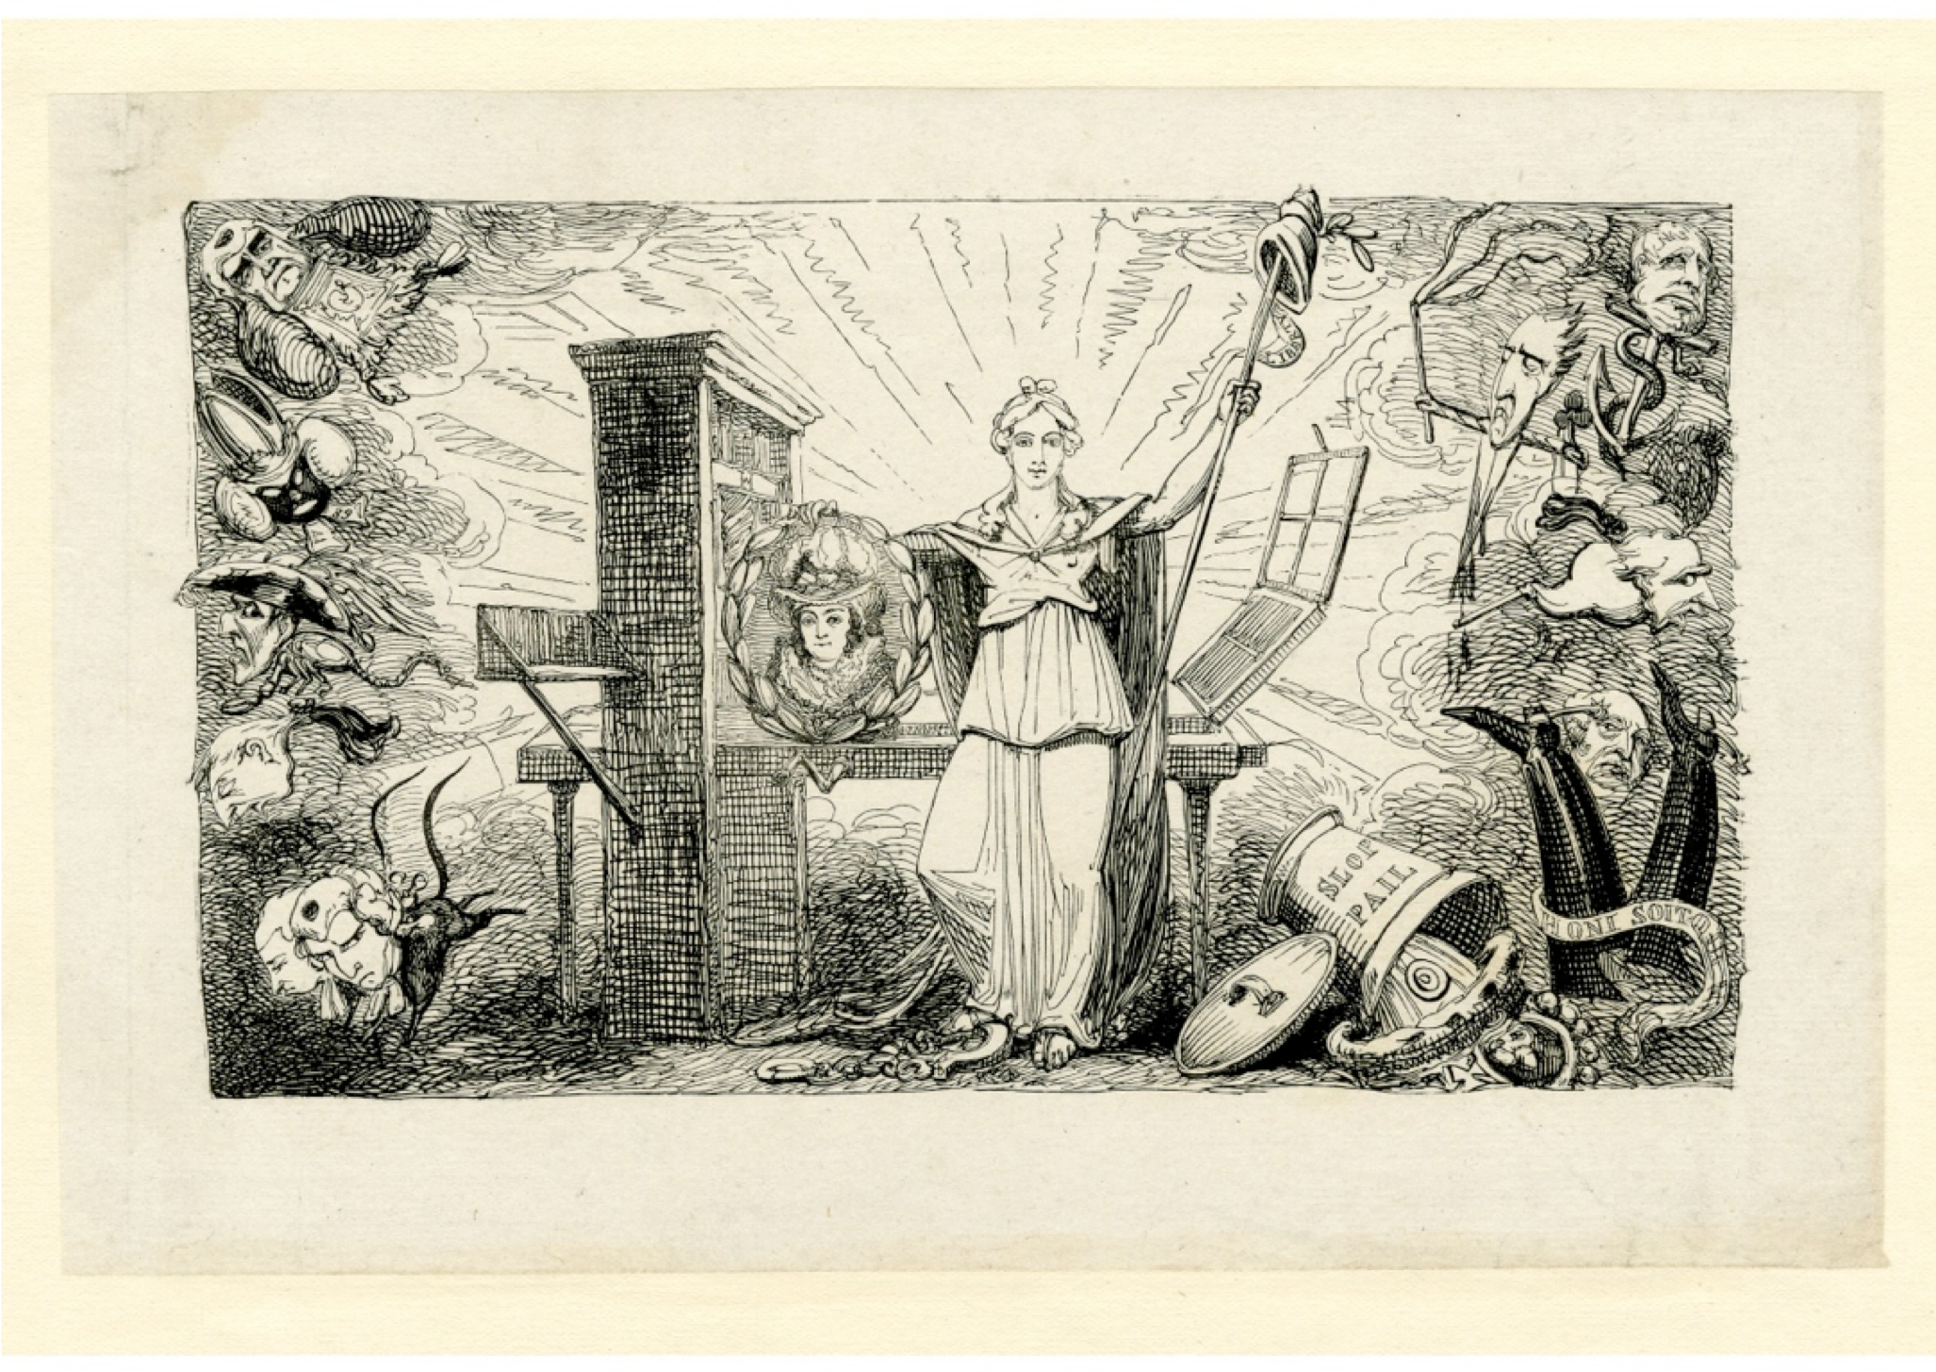
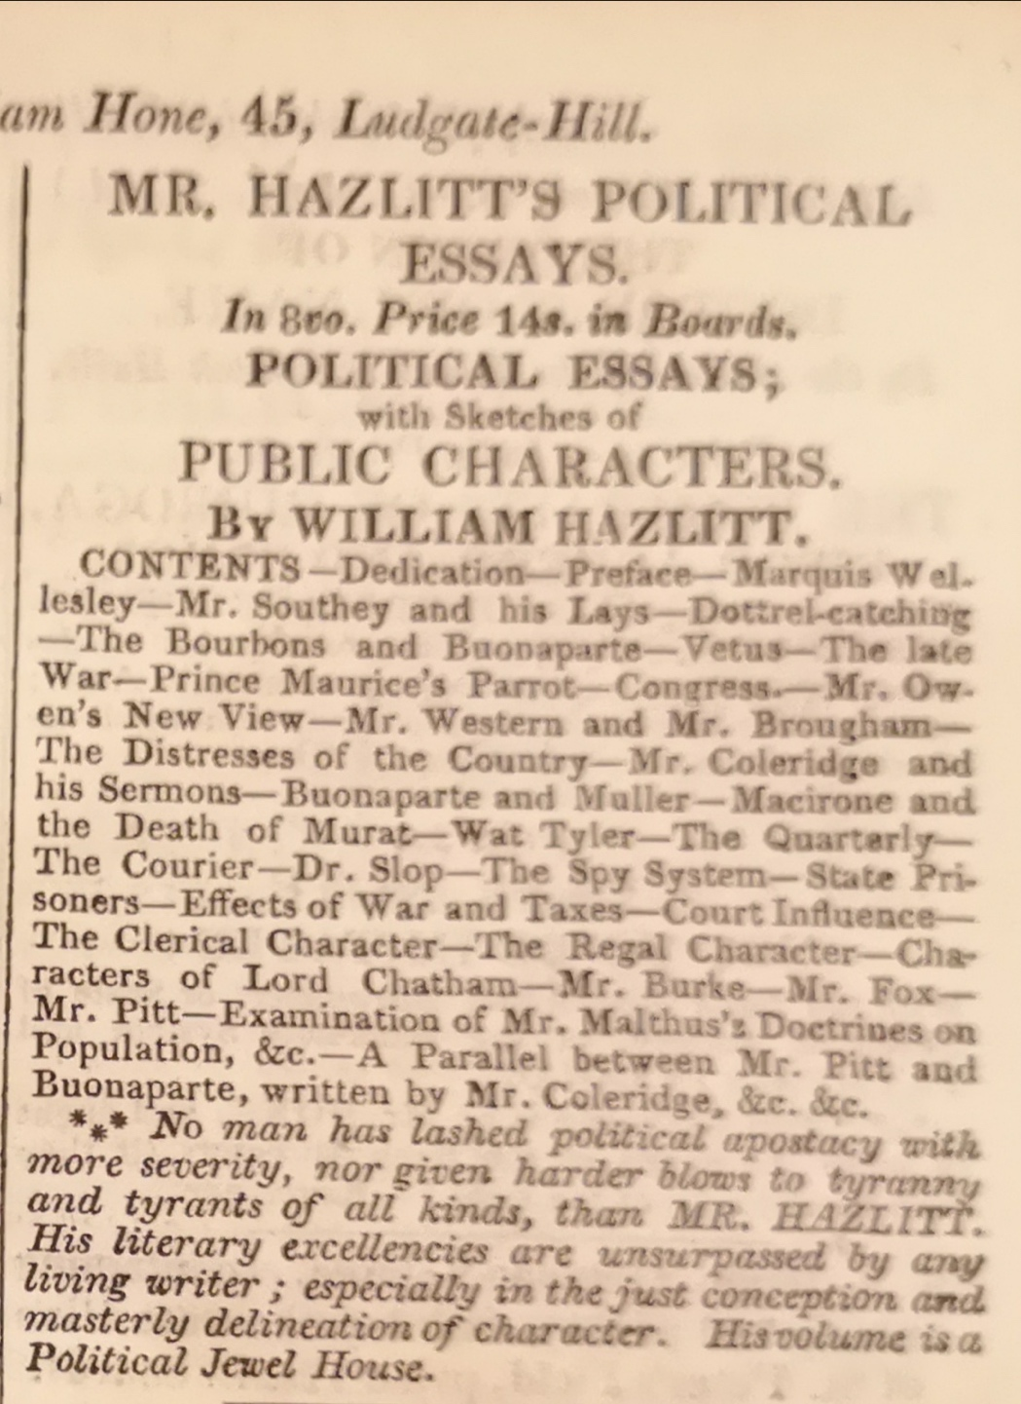


Slide 11
‘What was the situation of the country in November 1819? Do I exaggerate when I say, that there was not a man of property who did not tremble for his possessions’. George Canning, Speeches of the Right Hon. George Canning Delivered on Public Occasions in Liverpool, (Liverpool: Kaye, 1825), p. 299.
From that fatal day when the sword was drawn and war declared against the people of England, by the bloody and unavenged massacre of defenceless men, women and children of Manchester, I was one of those who made up their mind that all further praying and petitioning ought to be at an end, that the time for Reform was past and the hour of Revolution come. John Gale Jones, Cited by Royle, 53.
‘Things have reached their climax: but a REVOLUTION will be either prevented, or induced, according as the MIDDLE ranks bestir themselves during the REBELLION. If your dependence is placed upon your ARMY alone, for the suppression of a general insurrection, your expectations will be disappointed.’ Lionel Thomas Berguer, A Warning Letter to His Royal Highness the Prince Regent, Intended Principally as a Call Upon the Middle Ranks, At this Important Crisis (London: T. and J. Allman, 1819), p. 36.

Slide 12
The cavalry were in confusion: they evidently could not, with all the weight of man and horse, penetrate that compact mass of human beings; and their sabres were plied to hew a way through naked held-up hands, and defenceless heads; and then chopped limbs, and wound-gaping skulls were seen, and groans and cries were mingled with the din of that horrid confusion. ‘Ah! Ah!’ ‘for shame! for shame!’ was shouted.
Samuel Bamford,
From Passages in the Life of a Radical (1838)
William Hone, from A Slap at Slop and the Bridge Street Gang

Slide 15
‘The author of Wat Tyler was an Ultra-Jacobin; the author of Parliamentary Reform is an Ultra-royalist’ (‘Wat Tyler and the Quarterly Review’, Political Essays, Howe vii, pp 169-70)
That Mr. Southey was a mere boy when he wrote WatTyler, and entertained Jacobin opinions: that being a child, he felt as a child, and thought slavery, superstition, war, famine, bloodshed, taxes, bribery and corruption, rotten boroughs, places and pensions, shocking things; but that now he is become a man, he has put away childish things, and thinks there is nothing so delightful as slavery, superstition, war, famine, bloodshed, taxes, bribery and corruption, rotten boroughs, places and pensions, and particularly, his own. (‘The Courier and “The Wat Tyler”’ Political Essays, vii p. 181)

Slide 16
‘We have nothing to do with Mr. Southey ‘the man’, or even with Mr. Southey the spy and informer. Is it not a little strange, that while this gentleman is getting an injunction against himself as the author of Wat Tyler, he is recommending gagging bills against us’.
[…]
‘Mr. Canning […] what a pitiful spectacle does his sneaking, servile adherence to a party make, compared with Mr. Southey’s barefaced and magnanimous desertion of one! Mr. Canning has indeed served a cause; Mr. Southey has betrayed one. (‘The Courier and “The Wat Tyler”’, Howe, vii, pp. 177-179.—the Examiner 30 March 1817)

Slide 17
3365. Robert Southey to William Peachy 15 October 1819
‘May it please your Royal Highness
We the undersigned Nobility, Magistrates, Gentry, Clergy & Freeholders of the County of Cumberland; feel it our duty at this time to approach the Throne with a declaration of our loyal attachment to the established Institutions of these Kingdoms, in opposition to the principles & practises by which their security is endangered & the peace of society disturbed. […] And should your Royal Highness be advised to recommend to Parliament the adoption of restrictive measures to check the diffusion of licentious principles, & curb the audacious spirit of blasphemy & treason, we beg leave to assure your Royal Highness that much as we deplore the necessity for such measures, we will chearfully submit to them, with a full sense of that necessity, as the natural consequence of excesses which have at all times produced similar results’.

Slide 18
George Cruikshank, from A Slap at Slop and the Bridge Street Gang (London: William Hone, 1821)

Slide 19
From A Slap at Slop and the Bridge Street Gang, (London: William Hone, 1821

Slide 20
They regard men crawling on the face of the earth, as we do insects that cross our path [...] Without the common feelings of humanity in their own breasts, they have no regard for them in their aggregate amount and accumulating force. Reigning in contempt of the people, they would crush and trample upon all power but their own. They consider the claims of justice and compassion as so many impertinent interferences with the royal prerogative. They despise the millions of slaves whom they see linked to the foot of the throne; and they soon hate what they despise. [...] Their blind fatuity and insensibility to all beyond themselves, that, transmitted through successive generations and confirmed by regal intermarriages, in time makes them idiots. (Hazlitt, ‘On the Regal Character’, Political Essays and Examiner 29/8/1819)
‘I have been commanded by His Royal Highness to request that your Lordship will express to the Magistrates of the county palatine of Lancaster, who attended on that day, the great satisfaction derived by His Royal Highness from their prompt, decisive, and efficient measures for the preservation of the public tranquillity.’ (letter from Lord Sidmouth to the Earl of Derby forwarding the Regent’s congratulations to the magistrates who had instructed the Manchester Yeomanry’ The Examiner 29 August 1819)

Slide 21
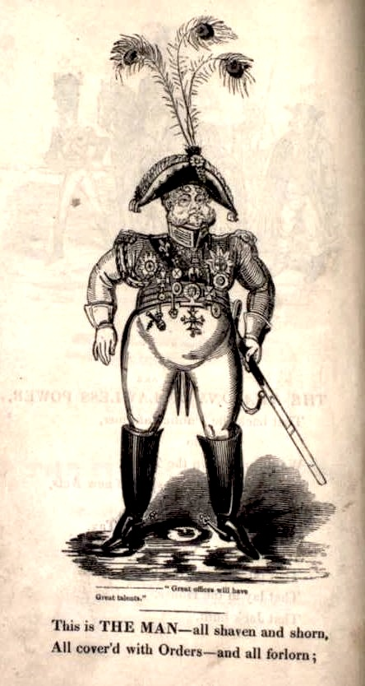
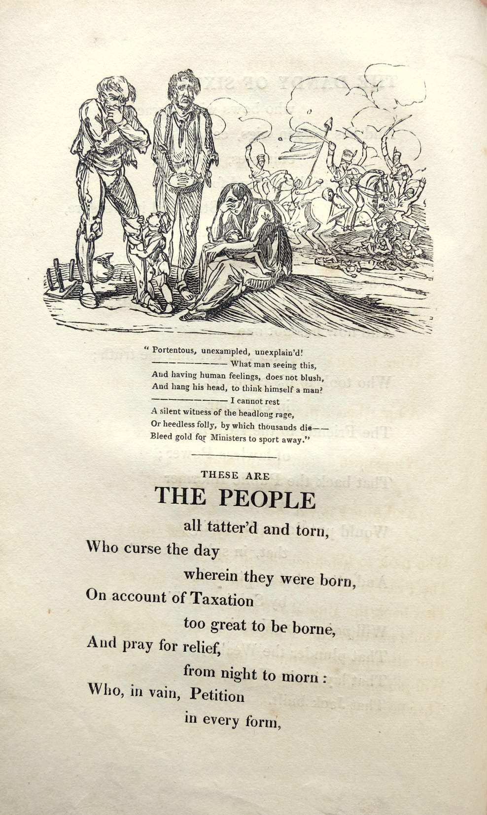
These are THE PEOPLE all tatter'd and torn,
Who curse the day wherein they were born,
[…]
Who, in vain, Petition in every form,
Who, peaceably Meeting to ask for Reform,
Were sabred by Yeomanry Cavalry, who,
Were thank'd by THE MAN, all shaven and shorn,
All cover'd with Orders--and all forlorn;
(From The Political House that Jack Built, (William Hone, 1819

Slide 23
Hazlitt from ‘On the Clerical Character’, Political Essays:
‘The public are a spy upon him, and he wears a mask the better to deceive them.’
‘systematic spies and informers against immorality’
‘Priests were the first deluders of mankind’
‘secret alliance between Church and State’
‘the Established Clergy of all religions have been the most devoted tools of power. Priestcraft and Despotism have gone hand-in-hand—have stood and fallen together’.
‘Priests are naturally favourers of power’
‘great Eaters’
George Cruikshank, ‘A Mask’ from A Slap at Slop and the Bridge Street Gang (London: Wm. Hone, 1821)

Slide 28
The Spy System

Slide 33
Mr Walter’s hair stands on end, and he is in a perfect cold-sweat at the sacrifices and dangers he has been exposed to in making head against the abuses of power. He gives one desperate instance. He ventured to condemn ‘the Manchester massacre’ –a measure that only one man in the three kingdoms was forward to applaud. Yet with public opinion at his back, with popular clamour, with the indignant storm of all ‘the honest and independent part of the community’ directed against this illegal, unmanly, and indecent outrage, the Editor of the Times looks back with horror to the dangers that beset him, and the gauntlet he ran through—’ scared at the sound himself had made’ […] What we have still to learn is an instance where the Times has raised a popular ferment, not when it has joined in the cry.’ (Hazlitt, ‘Remarks on a paragraph in the Times, Relating to an Article in the Edinburgh Review’ (The Examiner, 8 September 1823, Howe, XX 142-143)

Slide 34
‘where Hazlitt’s negative treatments of popular mobilization were often grounded in specific events (Birmingham in 1793, London in 1820), it is it is striking that the positive urban Leviathan was advanced as a supposition or figural “type and image,” without direct reference to celebrated radical episodes in the era of Peterloo—events that were available to him, and that suffused the periodicals in which his essays appeared.’ (Kevin Gilmartin, William Hazlitt Political Essayist, OUP, 2015),273.

Slide 35
‘That abstract principle is, of course, the ‘discovery’ of the Essay on the Principles of Human Action, by which every individual is endowed with an innate power of self-determination. Abstraction itself is the culmination of that power, marking the deepening of perception beyond the merely local, and separating the ideal from that which is petty and personal. […] Hazlitt's abstract ideal is not deontological or “objective” in the conventional sense, but a universal’.
Uttara Natarajan ‘Essays Political and Familiar Two Aspects of Hazlitt's Ideal’ chapter in Hazlitt and the Reach of Sense: Criticism, Morals and the Metaphysics of Power (Oxford, 1998)

Slide 36

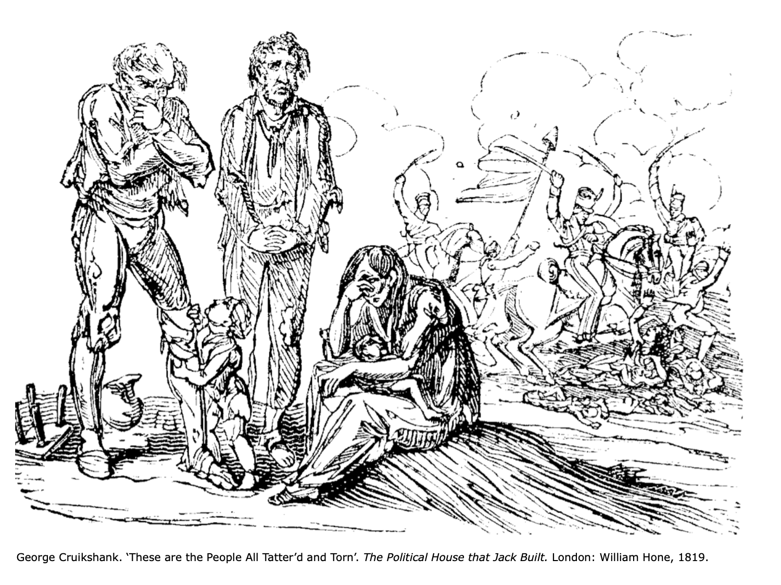
It was at the ‘Southampton’ that Mr. Hazlitt, Mr. Cruikshank, and Mr. Hone used to meet and discuss the subjects for Hone’s next squib. I believe that my grandfather is answerable for some of the outlines of these, and for suggesting to Cruikshank what he thought was the salient point for illustration. The story goes that he was once trying to make himself understood to Cruikshank, when the latter got up, and dipping his finger in his ale-glass, traced something in beer on the table. “Is that what you mean, sir?” he asked, and my grandfather assented.
William Carew Hazlitt, Memoirs of William Hazlitt, 2 vols. (Richard Bentley, 1867), I, 300.

Slide 37
[…] I have staked health and wealth, name and fame upon, and am ready to do so again and to the last gasp, is this, that there is a power in the people to change its government and its governors. That is, I am a Revolutionist: for otherwise, I must allow that mankind are but a herd of slaves, the property of thrones, that no tyranny or insult can lawfully goad them to a resistance’. (From ‘The Establishment of the Empire’, Life of Napoleon, Howe, xiv, p. 236)

