Slide 1
Understanding study recruitment behaviour of Health Visitors and Community Midwives:
An application of the Theoretical Domains Framework
Dr Jennie Rose
Email: jennie.rose@anglia.ac.uk

Slide 2
Poor study recruitment
Is widespread across health research¹
Is the most common reason for discontinuation of RCTs²
Sampling bias reflects health inequalities³
Threatens external validity, reduces statistical power⁴
Poses a barrier to reducing health inequalities³
Urgent calls for interventions to improve recruitment³
Currently, little evidence of intervention effectiveness⁵

Slide 3
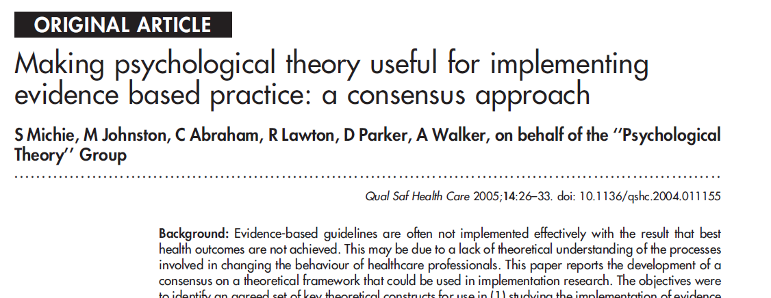
A theoretically grounded systematic approach
To identify the barriers and facilitators to study recruitment
Allows appropriate behaviour change theories to be identified
Enables interventions informed by behaviour change theory to be developed before starting a research study/trial
6

Slide 4
Methods
Setting and participants
Community settings in England
Health visitors and community midwives (N=114; response rate =37%)
Four NHS Trust, one Community Partnership
Design & data collection
A self-reported, anonymous, online, cross-sectional survey
Questions adapted from the Theoretical Domains Framework
Analysis
Directed content analysis of qualitative data

Slide 5
Results
Two domains identified among 80% of responses
GOALS - CONFLICT WITH/PRECEDENCE OF OTHER
“It would not be prioritized, as the key performance indicators are what the commissioners are measuring our performance on and paying us to deliver”
BELIEFS ABOUT CONSEQUENCES – negative & positive
“Research is vital for us to be able to practice in an evidence-based way”
“I think for these clients if I were to discuss research participation it may be intimidating for them and further marginalise them”

Slide 6
Results
Three other theoretical domains also identified as influencing recruitment behaviour for over 75% participants.
Social/professional role and identity (particularly beliefs about the caring role)
Intention (to inform patients about research)
Knowledge (about the background and purpose of the study)

Slide 7
Next steps
Plan how recruitment activity can be accommodated amid competing priorities
Directly address beliefs about negative consequences of research
Align research recruitment activity with a valued caring identity
Support professionals to gain a secure understanding of research aims and processes

Slide 8
References
Gul RB, Ali PA. Clinical trials: the challenge of recruitment and retention of participants. J Clin Nurs. 2010;19(1-2):227-233. doi:10.1111/j.1365-2702.2009.03041.x.
Kasenda B, von Elm E, You J, et al. Prevalence, characteristics, and publication of discontinued randomized trials. JAMA. 2014;311(10):1045-1051. doi:10.1001/jama.2014.1361.
Bonevski B, Randell M, Paul C, et al. Reaching the hard-to-reach: a systematic review of strategies for improving health and medical research with socially disadvantaged groups. BMC Medical Research Methodology 2014;14(1):1-29. doi: 10.1186/1471-2288-14-42
Watson JM, Torgerson DJ: Increasing recruitment to randomised trials : a review of randomised controlled trials. 2006, 9:1-9.
Preston NJ, Farquhar MC, Walshe CE, et al: Strategies designed to help healthcare professionals to recruit participants to research studies. 2016. Cochrane Database of Systematic Reviews 2016 (2) doi:10.1002/14651858.MR000036.pub2.
Michie S, Johnston M, Abraham C et al. Making psychological theory useful for implementing evidence based practice: a consensus approach. Qual Saf Health Care. 2005;14(1):26-33. doi:10.1136/qshc.2004.011155.
The I-Recruit Team
Dr Jennie Rose – Anglia Ruskin University
Professor Sarah Redsell Anglia Ruskin University
Dr Jane Akister, Anglia Ruskin University
Dr Fiona Maxton, NIHR CRN Eastern
Kieran Lynn, Anglia Ruskin University

