Slide 1

Social Media, Resistance and Local Food and Drink Firms: The Case of #EATCambridge
Michael Duignan | Lewis Walsh | Sally Everett
Anglia Ruskin University, Lord Ashcroft International Business School
Notes:
Welcome to the project…
Apologies for Sally…
Mike → Lewis introductions…

Slide 2
Quick snapshot…
An introduction in to EAT Cambridge, the project beginnings and Cambridge context…
Establish rationale and methodological decisions.
Key project findings and discussion points.
Main findings, discussion points and conclusions.
Outputs, ‘impacts’ and future agenda…

Slide 3
Study objectives…
1) How are alternative food providers engaging with Eat Cambridge? What are the perceived benefits in terms economic and social value?
2) How can Eat Cambridge support local producers to build their brand and foster a sense of community of food and drink in and around Cambridge?
3) In what ways does social media coverage through #EAT Cambridge benefit producers, consumers and offer an effective marketing vehicle of promotion?

Slide 4

So, what is
EAT Cambridge…
EAT Cambridge - Eat Cambridge is an annual food and drink festival showcasing Cambridgeshire’s delicious independent food scene…
…Taking place for two weeks every May, the festival was founded in 2013 by three local food lovers and is organised and run entirely by volunteers. Every year, Eat Cambridge’s Main Event and two-week fringe event programme feature the best, newest, and most exciting independent food and drink in the area (EAT Cambridge, 2016).
Notes:
To give you an idea of what the festival looks like, here a short 1 minute video
https://www.youtube.com/watch?v=PJ6B1QFjpfo

Slide 5
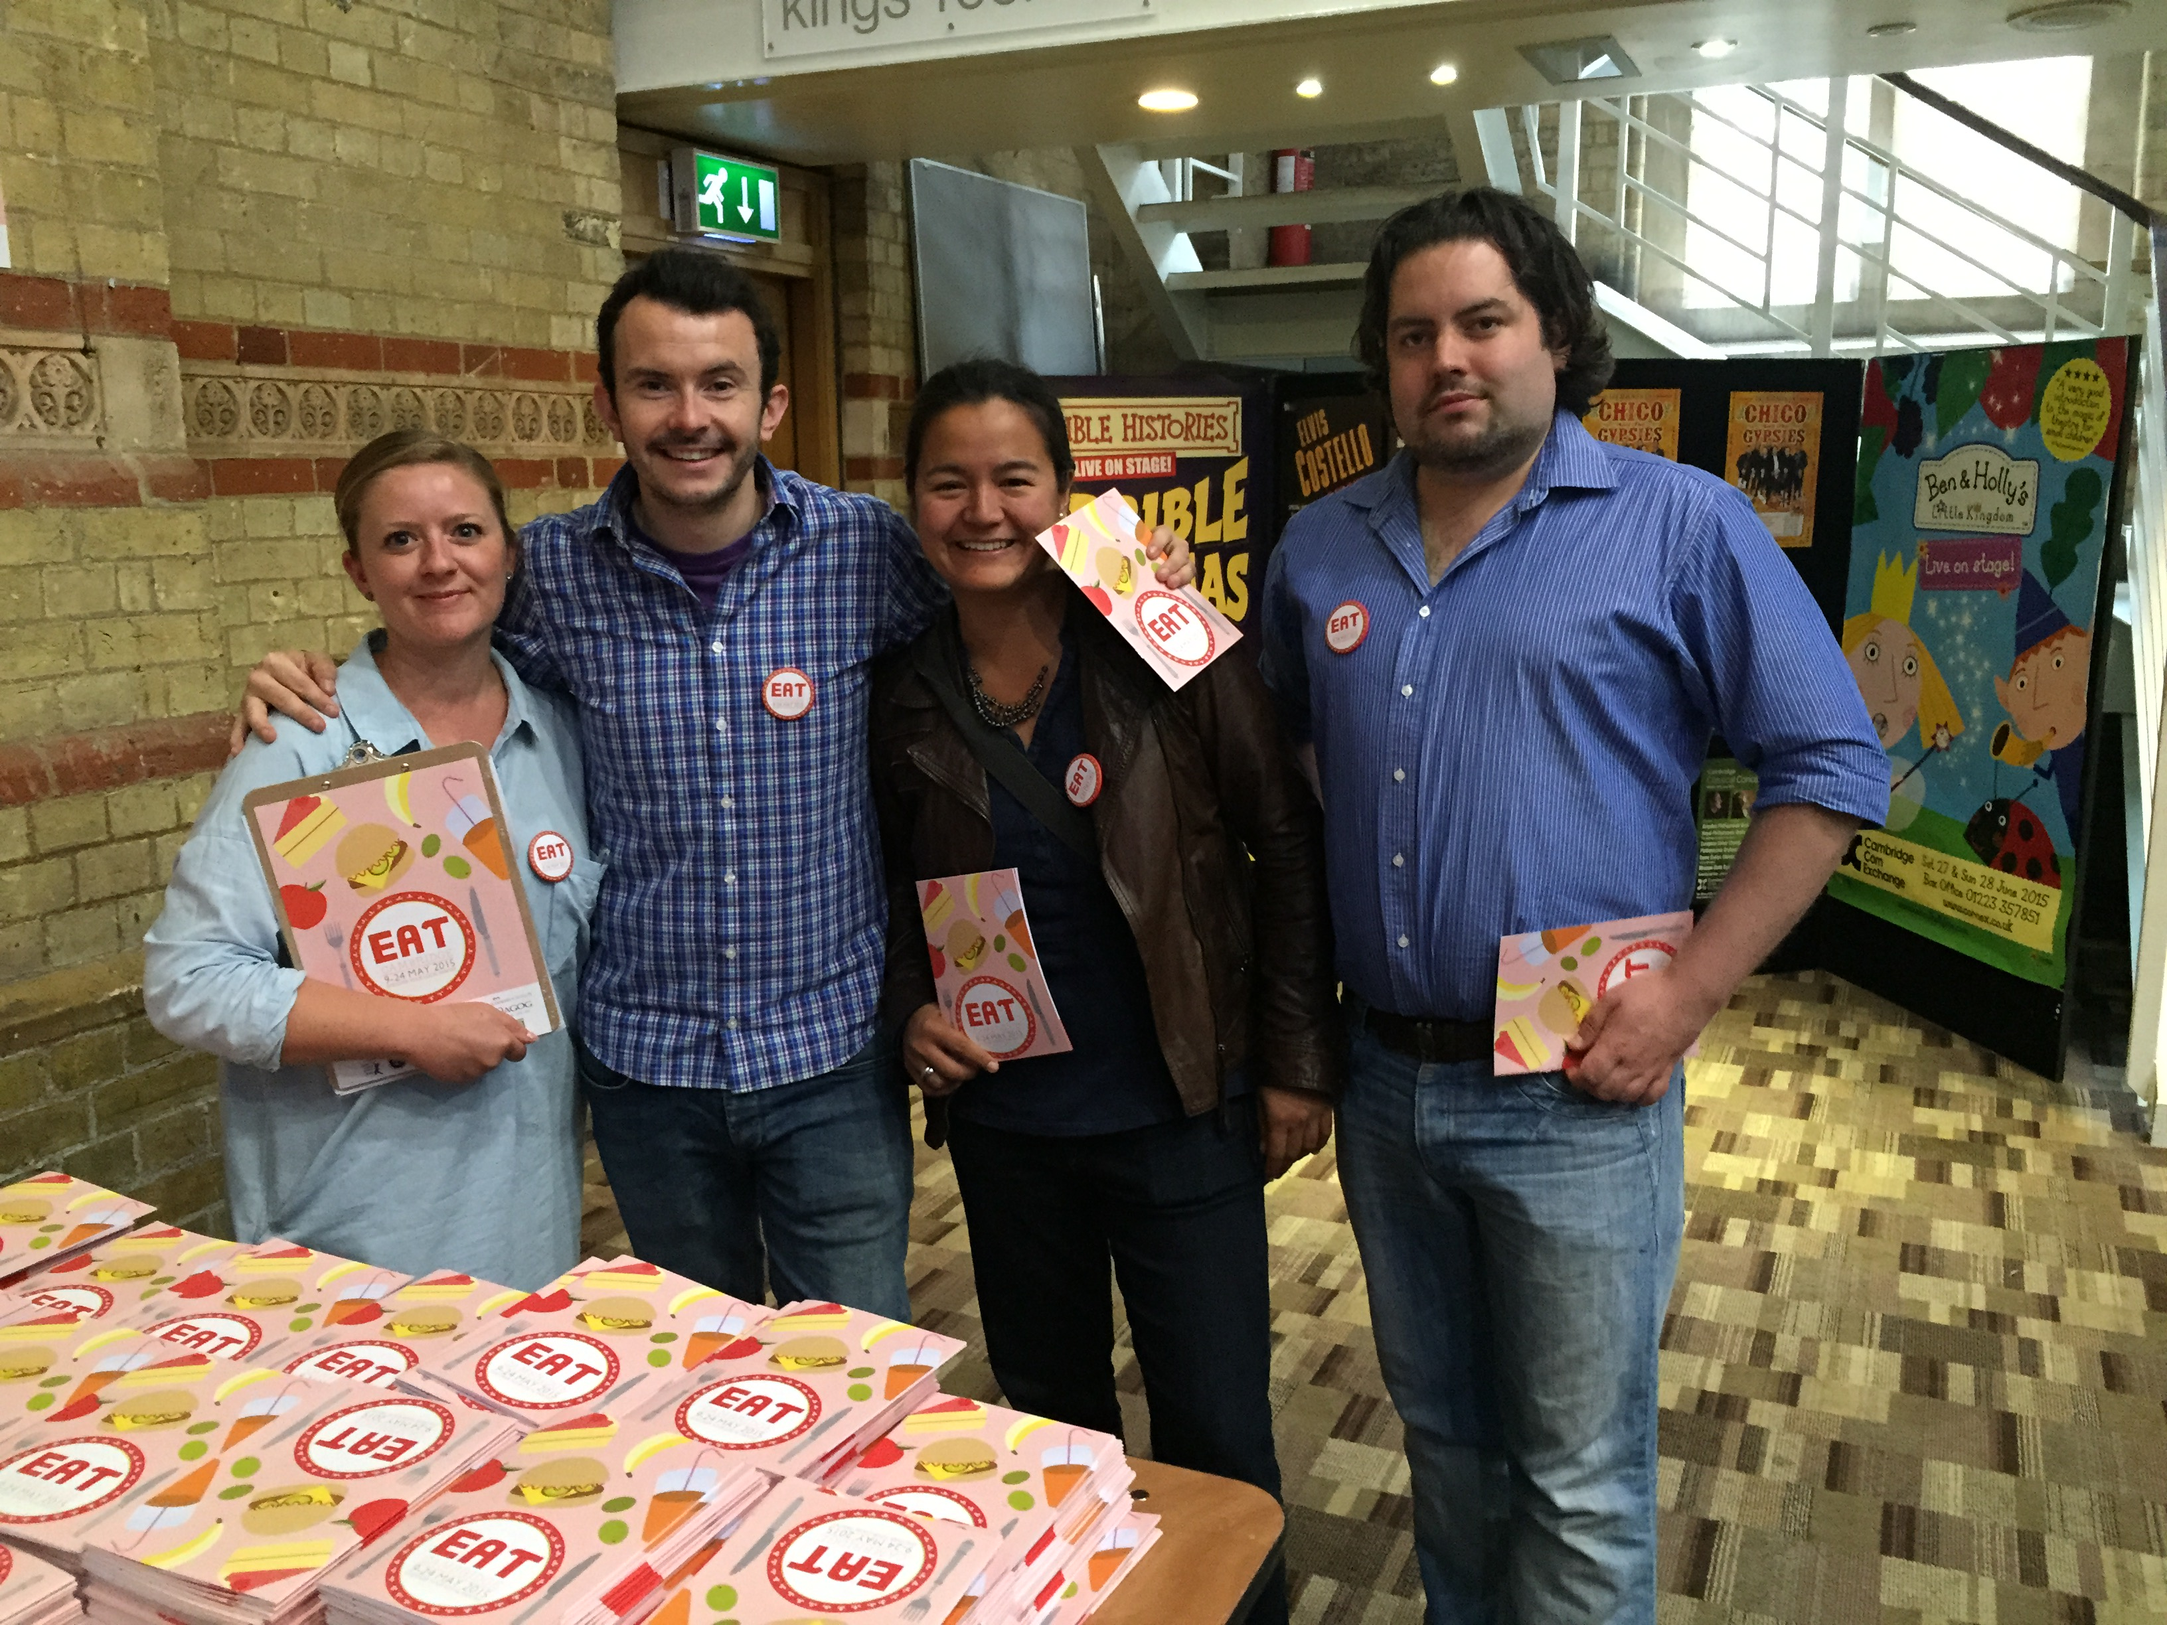
Why food festivals, social media focus, and the project evolution…
For the LOVE of food and drink(!!) – a great excuse…
Positive food image crucial in destination promotion & key factor in visitor destination choice (Beerli and Martin, 2004; Everett, 2016).
Social media inexpensive for small firm marketing and networking critical for their success (as shortly revealed..).
Networks vital for small business survival (O’Brien, 2006).
Local, small firms through social networking help galvanise promotion of regions, cities, towns… (REF?)
On-going strategic agenda to co-create digital footprints between top-down DMO policy and small business (Visit Cambridge, 2016)
Notes:
After going through the slide points…
On another level…
The project started with a friend. A friend who happened to be a festival director: Heidi Sladen (zoom to pic). In essence, she wanted us to conduct an economic evaluation of the local economic impacts of the EATCambridge festival to help (of course, if data indicates) support the case public sector funding and gather political and economic support (to boost grassroots festivals/events as a noteworthy injector). There was also the additional objective of also illustrating the benefits to small traders to continue their participation and increase the likelihood of small-medium sized business sponsorship. Both were the main income streams for the festival.
My prior London 2012 mega-events - and forthcoming Rio 2016 - research has been focused on host business community ‘event leveraging’ and redistributing the benefits of local event visitor consumption toward less visible communities that surround the chosen venues for the ‘event’. And whilst comparing mega-events to local festivals would be methodologically problematic, the question of how small businesses reap the associative rewards (either through participation as a trader or as an official sponsor) and leverage entrepreneurial opportunities is an important one in light of the challenges I discuss shortly...

Slide 6
Beginnings and context…
Strategic linkages with local authority tourism – come – DMO launch in January 2016 (e.g. Visit Cambridge, 2016)
One of the real challenges for Cambridge from a tourism perspective is that it is still perceived by many as a day trip destination. The opportunity exists now, through the development of the new Destination Management Organisation, which has no geographical boundaries, to develop and promote the narrative of the broader area, therefore encouraging visitors to stay longer, explore further and create more value from our vibrant visitor economy (Emma Thornton, CEO Visit Cambridge and Beyond)
‘8 hour tourist’ and ‘on the beaten track’ problematic
Figure [1] – Day visitors and staying visitors (Tourism South East, 2010)
Notes:
Provide linkages with both Council and DMO priorities (see EAT paper and Duignan and Wilbert (2016, forthcoming) – the strategic alignment between the notable effects of festivals of this kind and the ability for them to extend visitor stays, engage with communities is strong and thus reduce the number of 1 day visitors to the city.

Slide 7
Critical perspective and justification: the Clone Town?
Cambridge – a ‘Clone Town’ (e.g. NEF, 2010)? Shifting business demographics away from independents…
On-going rationale for event impact – small
business perspective…
Driven by theoretical and empirically evidenced benefits of food festivals for small business leverage, enhancing destination image, competitiveness and visitor choice… but structural economic factors …
Strategic alignment between academic, festival, policy…
Notes:
1. Critical issue of structural economic changes due to exhorbitant rents (which is not uncommon for touristic-historic cities e.g. Maitland) across core and inner city urban areas, resulting in the homogenisation of business offerings from local, independent to further permeation of corporations in to these central spaces. The New Economics Foundation (NEF) refers to this as the ‘Clone Town’ effect. And Cambridge, despite concentrated peripheral communities of small inde businesses (which are marvellous if you have never been… but please stay for more than one day!!), the very inner central urban areas under investigation are fully saturated by the global and national corporations.
From my engagement with regional destination policy, these effects look like they are set to intensify (but interestingly, from direct experience sitting on the DMO advisory board there is perhaps a failure to identify the potential damaging effects of this on the destination image of the city due to standardisation effects – reducing place competitiveness)…
Although DMO organisational and funding structures differ between regions, e.g. some are 80% public and others like Cambridge are even 90% private – the entrepreneurial forms of governance dominant the internal logic of tourism management and destination development. Narratives of economic growth, business representation from established businesses in the city on the board is the norm…
Who knows Cambridge well? You can see this continued change throughout the city: multi-cultural street Mill Road (bit like Brick Lane) small units transforming in to Pizza Hut delivery, Sainsburys, right through to the subtle shift of inde clothes stores turn in to Joules – for example.
- Given Cambridge’s strong economic position in the visitor economy, alongside striving for the economic objectives of the DMO to extend stays and create a ‘slower’ offering, Duignan and Wilbert (2016 forthcoming) illustrate the need to redistribution of visitor expenditure across less visible and locally orientated spaces (echoed also by Everett, 2016).
Transformative growth of food providers, via the use of ‘food trucks’ turned to occupy peripheral spaces, and more transient geographical locations - development land near train station, side streets of business parks, peripherally located barns at the back of Cambridge Uni Institute of Astronomy. Nomadic and fluid, opportunist, ever changing locations – I urge you to keep this in mind…
Rationale for the small business perspective
---In-depth exploration and detailed qualitative analysis of event impacts needed from small business perspective and often de-particularised and thus requiring unpacking of impact at the local-case study level (e.g. Pappalepore and Duignan, 2016)
---Event impact generally piecemeal and fragmented, and often focused on the positive more tangible outcomes (Hiller, 2005).
---…all specifically with respect to food and drink providers and the relationship between tourism events and social media (Hudson et al, 2015).

Slide 8
Methodology
Approach: two year event case study of EAT Cambridge 2014 and 2015, inductive, exploratory, qualitative, applied to problem.
Method: 3 data sets – 1) survey (2014 and 2015), 2) in-depth interviews (2014-2015), 3) content analysis of strategic policy documentation (e.g. local authorities and DMO).
Total of… x29 survey responses (2014 - 2015) and x54 in-depth interviews (2014 – 2015) with…
Sample: purposive and bounded to those involved in the organisation of the festival (e.g. directors), senior tourism (e.g. DMO), and traders themselves (small firms – from gin to bakers).

Slide 9
IN vs. OUT
A key challenge for the responding businesses was the combination of the Cambridge high street being dominated by chains and the clustering of tourists driving up rent prices.
Two types of businesses we interviewed:
  ‘IN’ businesses: Made it to the centre and exhibited a competitive attitude of wanting to “take on the kind of corporate giants that are in the game”
  ‘OUT’ businesses: The majority of local food providers, these did not operate in the city and felt that they were being pushed out to the periphery areas of the city, away from the zones frequented by tourists.
Notes:
A key challenge for the responding businesses was the combination of the Cambridge high street being dominated by chains and the clustering of tourists driving up rent prices.
Some businesses we interviewed had made it to the centre and exhibited a competitive attitude of wanting to “take on the kind of corporate giants that are in the game” these were denoted as the ‘IN’ businesses. Unfortunately the majority of local food providers did not operate in the city and felt that they were being pushed out to the periphery areas of the city, away from the zones frequented by tourists. These were the ‘OUT’ businesses.

Slide 10
IN vs. OUT (continued)
‘IN’ businesses accepted reality of high rents and wanted to be ‘figureheads’ of foodie movement and clustering (e.g. Bennett St nicknamed Meat Street).
    “We are in a really good location, rather than let’s say being out in the periphery, where it might have taken longer to prove our business and get recognition from customers and alike” , and “I think for it [business] to really take a foothold, you have to have permanent locations…so we can actually take on the kind of corporate giants that are in the game” .
    “I think there’s just power in numbers. So, the greater the scene gets, the more people (customers) will use it and rely upon it, and support it. And that will attract more people into either districts, or the city centre” . “We want to become one of those figure heads who do that in the community, we don’t want to be just an operator that serves nice meals and nice drink, we want to actively encourage other foodie businesses to follow” .
Notes:
‘IN’ businesses had a more positive, or at least ambivalent, attitude to the high city centre rents. We believe this view to be attributed to the fact these businesses have contact with what has become called the ‘8 hour tourist’ (day trippers) and that these producers ‘have broken down barriers and made it into the centre’ (Heidi White,).
These ‘in’ businesses wanted to prove that they could compete with the ‘chain’ businesses, to set an example to the rest of the foodie movement. “We are in a really good location, rather than let’s say being out in the periphery, where it might have taken longer to prove our business and get recognition from customers and alike” (BROL3), and “I think for it [business] to really take a foothold, you have to have permanent locations…so we can actually take on the kind of corporate giants that are in the game” (BROL3).
These ‘IN’ businesses also looked to cluster in areas (one such cluster is affectionately known as ‘Meat Street’) and wanted to be ‘figure heads’ in the foodie movement and encouraged other foodie businesses on the periphery to join them “I think there’s just power in numbers. So, the greater the scene gets, the more people (customers) will use it and rely upon it, and support it. And that will attract more people into either districts, or the city centre” (BROL3). “We want to become one of those figure heads who do that in the community, we don’t want to be just an operator that serves nice meals and nice drink, we want to actively encourage other foodie businesses to follow” (BROL3).

Slide 11
IN vs. OUT (Continued)
OUT businesses: felt negative, dis-enfranchised, and focussed more on survival than competing. More reliant on the EAT festival to draw consumers away from city centre to overcome their marginal locations on the edge of the city (and resist the more powerful inner city and corporate entities).
    “Find me a space! I’ll open a deli! Find me a space that doesn’t cost three thousand pounds [a month]…we could never afford somewhere in the city centre”.
Both ‘IN’ and ‘OUT’ businesses used food festivals like EAT for networking, marketing, and direct trade.
Notes:
‘OUT’ businesses were much more defeatist about their chances of acquiring city centre trading space. These food business talked less about fighting back against the chain’s and more about ‘surviving’ (IC2 [2]) and ‘making a living’ (DB 5) having been locked out of the main city centre market; they were trapped on the outside. These ‘OUT’ business relied much more heavily on the EAT festival to overcome their marginal location by using the event to draw consumers away from the city centre
At EAT participating firms (both IN and OUT) saw the event as a marketing exercise, rather than for strict revenue generation. We found that respondents often took part in what was termed as ‘in person’ marketing whereby they would converse with consumers and engage other participating businesses to create relationships. These relationship would then be nurtured on social media once the physical event had ceased

Slide 12
#EATCambridge: Physical and Digital Nurturing
EAT festival catalysed relationships between small firms and consumers which were then nurtured via social media after the physical event ended;
Nurturing the relationship on social media
Twitter was dominantly used by all respondents to engage consumers and other businesses;
Social media and the event itself allowed owner/managers to illustrate and educate ‘followers’ about their local roots and values:
  “I think people need to be educated that you can buy nice things...So promote it, push it forward, and make Cambridge a healthy place”
  “The more people we educate at events [EAT] to ask for local beer and quality beer rather than Carling or Fosters, because those big brands don’t go with the image that people are trying to create with their food”

Slide 13
Digital #EATCambridge: Small Firms Before and During the Event (Continued)
Social media and the event itself also catalysed B2B collaboration and cross-fertilisation of products
  “We wanted to meet and engage with other traders, one such relationship saw us agree with an ice cream trader to turn my waste product (gin soaked raspberries) into a boozy ice cream”
Notes:
Businesses whom struck up a relationship at the event were able to continue that relationship after the event by following one another. Not only did their engagements act as content for their social media feeds but it also led to collaborations. “We wanted to meet and engage with other traders, one such relationship saw us agree with an ice cream trader to turn my waste product (Gin soaked raspberries) into a boozy ice cream”

Slide 14
Beyond the event… physical and digital ‘traceability’ of small firms
Social media allowed for tracing the development of the product and how it gets to the consumer (supply chain)
  “Our crisps are made from potatoes on our farm we often make a big deal of our harvest and show those potatoes being turned into crisps, being packages and distributed”
Tracing the company’s values (what led them to be ‘locally’ focussed)
    “We are quirky, we are quintessentially British, we feel we are more of a brand and really sticking by that we can adapt so many things, and be able to tell people in a way that is a lot easier than them reading it in a magazine”;
  Continue to educate to increase modes of ‘critical consumption’
  “The good thing about those events [food festivals] is you can have a conversation with people about how you make your products and the provenance of it, and they realise that the difference of buying a salami from me or from buying salami from Tesco’s made in a factory or wherever, so I think they realise that difference” .
Notes:
2. Looking at the quote from one respondent about how the being “quintessentially British and Quirky” we can see how Twitter was used to speak to their followers and communicate their companies values, as well as what led them to be locally focussed.
3. The quotes on educating consumers also helps fuether modes of critical consumption by giving consumers the knowledge to make informed decision about what they are buying, while these ‘educating messages’ come through social media those messages are humanised because the follower has actually met the producer at the food festival.
4. As well as being a medium for educating consumers and communicating values and local roots to their followers, social media also allowed consumers to literally follow where a business will be on a certain date. With many businesses not being able/willing to acquire a permeant site many of these operated a street traders. Social media allowed that business to tell the consumer where they would be – whether that was on a street corner or at another event.

Slide 15
Beyond the event… physical and digital ‘traceability’ of small firms (Continued)
For street traders in particular social media allowed consumers to trace the businesses physically across the city and in more ‘peripheral’ locations.
  “Because our food van is in a different place every day we would post on Twitter where going to be, whether that be a street corner or another event”

Slide 16
Critical points and conclusions…
Resistance: plight and challenges in the core, festivals seen as resistance to economic problems, new temporary and transient third spaces (Deleuze and Guattari, 1987)
Smoother spaces: Disrupting ‘core’ food and drink offering helping to re-distribute benefits through immediate leverage and longer-term legacy benefits of networks etc (e.g. Chalip, 2004).
Digital media: umbrella of #EATCambridge, local firms connect, collaborate and celebrate the alternative.
Traceability: Tracing the product, company values and geographical locations educate and afford greater propensity to engage in critical consumptions, an on-going…(Everett, 2016)
Legacy: re-distributing benefits to marginalised small firms forced to occupy peripheral location due to economics, festivals providing the physical and digital spaces here that afford these alternative narratives,.

Slide 17
Point to leave on…
Western capitalist countries such as the UK are not only seeing an erosion of public space in favor of private ownership, but such policies often make way for more homogenous forms of urban space, particularly the loss of diversity and corporatized standardization of the high street and centralized urban areas (Duignan and Wilbert, 2016 forthcoming – also see Miles, 2010).
Notes:
End with … this agenda is close to the author’s moral position, underpinned by a leftie desire to rework market imbalances, champion small business inclusion against a backdrop of naturalised assumptions around how cities, their urban spaces and communities should work and look like…
Echoing Harvey’s argument -- shift from managerialism to entrepreneurialism in urban governance. Business competitiveness, rather than social justice or equity or citizenship is the internalized logic of entrepreneurial governance, whereby cities make themselves “as attractive to footloose international finance as possible, foregoing any social programmes likely to be a burden on business by multinational companies who might otherwise invest in the city” (North, Nurse, 2014, p. 8).
Mechanisms that focus on readdressing these balances are a critical issue when considering sustainability agendas of local communities, in this case of small businesses, that often underpin the urban diversity and provide the glue that bonds the very fabric of our social world, engagements and being. But those communities that can be forgotten in the all out desire for capital accumulation …

Slide 18
Outputs and “Impacts”
Two practioner economic evaluation reports (2014 – 2016)
ATHE / Visit England sponsored National Award for Leadership in the Visitor Economy (Slow Tourism).
Public engagement strategies (e.g. x5 media, University of Cambridge Festival of Ideas, keynote at #EATCambridge, and also usage of digital networks (e.g. vlog, Twitter etc) to educate (e.g. resisting ourselves…).
Advisory board position: critical friend to champion the ‘slow’ objectives of the authors’ and business school UoA.
Conclusions of this, the festival economics, and DMO priorities strategically align together to support slower tourism offerings.
Currently in 1st round R+R for Journal of Marketing Management.
On-going, more in-depth analysis for #EAT Cambridge 2017 (more visitor data, small business and senior perspectives) – but award Heidi wants to expand and commercialise.
Notes:
- Impacts not in a sarky way, but in a cautious way.

Slide 19
References (LW do in car)

Slide 20
Thank you for listening and come and share a ‘slow’ beverage with us later ☺
Michael.Duignan@Anglia.ac.uk.
Lewis.Walsh@Anglia.ac.uk.
Sally.Everett@Anglia.ac.uk.
hello@movingfoodie.com (Heidi Sladen, EAT Cambridge Festival Director).

