Slide 1
Accounting to stakeholders under conditions of uncertainty
Dr Paul Sanderson
Cambridge Centre for Housing and Planning Research, University of Cambridge,
and Anglia Ruskin University
Accountability in Corporate Governance and Financial Institutions
19 June 2014
Centre for Business Law and Practice, School of Law, University of Leeds

Slide 2
Accountability
Account – story, and relatedly, accounting – process of telling of that story
Accountability (to) – obligation to tell that story
Accountability (for) – obligation to explain the story

Slide 3
Foci:
Political scientists: representatives' accountabilities to citizens (public/personal, instrumental/ethical, statutory/extra-statutory)
Management academics: managers’ organizational accountabilities (formal/informal)
OB (sociologists): focus on accountability as a social practice (strategic/moral)

Slide 4
Organisational Behaviour: relational approach to accountability
Accountability, the giving and demanding of reasons for conduct, is a social, a mutual process, a process that emphasizes the interdependence of human beings. It is both an expression of a sense of responsibility by one human being for the condition of another, and at the same time, by concretizing that sense of responsibility, serves to reinforce it. An account may therefore be considered to be ‘socializing’ or ‘individualizing’.
Accountability involves varied social practices by means of which we seek to remind each other of our reciprocal dependence: of the ways our actions unavoidably make a difference to each other (Roberts 1996 p40).
Thus even where power is asymmetrical, those giving and demanding accounts are bound together in practice …. to an extent.
Roberts, J., & Scapens, R. (1985). Accounting systems and systems of accountability—understanding accounting practices in their organisational contexts. Accounting, Organizations and Society, 10(4), 443-456.
Roberts, J. (1996). From discipline to dialogue: individualizing and socializing forms of accountability. In R. Munro & J. Mouritsen (Eds.), Accountability: Power, ethos and the technologies of managing (pp. 40-61). London: International Thompson Business.

Slide 5
Factors influencing perceptions of accountability relations
Michael O’Loughlin (1990) offers a model designed to ‘measure’ accountability in public administration which is essentially concerned with
(i) the power of those presenting accounts compared to their stakeholders
(ii) the quantity and quality of their communications (e.g. level of detail, language employed)
(iii) the degree of discretion in constructing the account
(I would also add the degree of value concordance)
O’Loughlin, M. G. (1990). What is Bureaucratic Accountability and How Can We Measure It?’. Administration and Society, 22(3), 275–302.

Slide 6
Back to accounts. What is the basis against which accounts are judged?
Criteria:
Law, rules, codes, standards, norms etc., etc.
… but what if those criteria are not fixed or are imprecise or flexible or soft law or codes or …..?

Slide 7
Flexible regulation, externalised Costs and economic growth drawing on Responsive Regulation (Ayres & Braithwaite 1992) Ayres, I., & Braithwaite, J. (1992). Responsive Regulation: Transcending the Deregulation Debate. New York: Oxford University Press.
… after all, flexible forms of regulation are encouraged
License revoked
Criminal penalty
Civil penalty
Warning letter
Persuasion (information, guidance, voluntary codes, etc.)
License suspend
Externalised costs from inefficient inflexible regulation
Economic growth, innovation etc.

Slide 8
Empirical research on voluntaristic corporate governance codes to examine aspects of regulatory flexibility
Project:
Soft Regulation? Conforming with the Principle of 'Comply or Explain,' ESRC (RES-000-23-1501)
Comparative research
UK: common law, liberalism (self regulation tradition), equity finance, dispersed shareholdings with concentrated institutional control.
Germany: civil law, corporatism, bank finance, family blockholdings
but similar codes of corporate governance, i.e. similar regulatory regimes
Data
Analyse 260 companies Corporate governance statements
Interviews with directors, CG managers, legal counsel etc.
Sanderson, P., Seidl, D., & Roberts, J. Taking soft regulation seriously? Managers’ perceptions of the legitimacy of corporate governance codes and ’comply-or-explain’ in the UK and Germany. (under revision for Regulation & Governance.)
Seidl, D., Sanderson, P., & Roberts, J. (2013). Applying the ‘comply-or-explain’ principle: discursive legitimacy tactics with regard to codes of corporate governance. Journal of Management & Governance, 17(3).
Sanderson, P., Seidl, D., & Roberts, J. (2013). The limits of flexible regulation: Managers’ perceptions of corporate governance codes and ‘comply-or-explain’ (Vol. Centre for Business Research Working Paper 439). Cambridge: University of Cambridge.

Slide 9
Comply-or-explain: the ultimate in flexible regulation
noncompliance = compliance (but only where regulatees provide acceptable accounts of their (non-compliant) actions to their stakeholders)
Regulatees must either:
demonstrate direct compliance with a rule (and underlying principle) or;
explain rule noncompliance (non-conformance) by demonstrating compliance with the underlying principle or;
explain why compliance with a rule (and possibly even the underlying principle) is not possible or is not desirable, i.e. not in the interests of stakeholders.

Slide 10
Accountability issues with comply-or-explain:
Formally compliant as long as an account is given but informally ……. is the account satisfactory ….. to whom, i.e. which stakeholders/shareholders, .. all!?
Accountability is not just presenting an account but entails a duty to explain action:
Is the decision to comply or to explain correct?
Is the level of detail provided in the explanation sufficient?

Slide 11
… which means ….
on the one hand
flexible regulation may make it more difficult for companies to satisfy diverse stake/shareholders
on the other hand:
stake/shareholders may find it harder to hold companies to account
however:
while providing any explanation may satisfy formal compliance, an explanation is only informally/morally compliant if stake/shareholders accept it

Slide 12
Q. Can we make sense of this ‘variable geometry?’ A. Perhaps companies’ perceptions of the instrument by which they are held to account is the starting point:
Cini (2001) notes, as ‘soft law is not legally binding, implementation must rest solely on the goodwill of those agreeing to and affected by it.’ From this, where such goodwill is absent, soft law may well result in soft compliance, poor accounts and lack of commitment to ‘being accountable.’
Hence the importance of the perceptions of regulatees of legitimacy (arising from underlying values, language etc.) of the legal framework, in our research the relevant corporate governance code.
If CG code is deemed legitimate by companies then comply-or explain is likely to be treated seriously and, arguably, accounts rendered in response to comply-or-explain also treated seriously.
Cini, M. (2001). The soft law approach: Commission rule-making in the EU's state aid regime. [Article]. Journal of European Public Policy, 8(2), 192-207.

Slide 13
Legitimacy: Analytical framework for CG research interviews
Moral legitimacy, bestowed on actions which promote the most cherished values, norms and beliefs of a society (Suchman 1995). For companies the moral legitimacy of a code depends upon their perceptions of the rightness of the outcomes of compliance. A typical example would be whether a corporate governance code is perceived to embody corporate best practice. (Note we only studied companies, not stakeholders but the latter may well judge accounts with reference to broader social values?)
Pragmatic legitimacy, arises from a specific private benefit being accorded (Suchman 1995), e.g. the code lowers the cost of capital for companies; For stakeholders, does the code/explanations provide benefit to me?)
Cognitive legitimacy, (Suchman 1995), regulators/regulatees draw on the same knowledge and so understand and empathize with each other, reinforced over time, ‘taken-for-grantedness’, e.g. the code is perceived as the only way to rule.
Suchman, M. C. (1995). Managing Legitimacy: Strategic and Institutional Approaches. The Academy of Management Review, 20(3), 571-610.

Slide 14
Moral legitimacy: (For companies ML exists if the code = best practice - UK>G)
“In many ways the Code came about from experienced City operators collaborating over what were the sort of elements that made companies operate well and effectively, trying to capture what until that time had actually been complicit in good management, and saying what are the signs of good management and how can we encapsulate that in a best practice guide as to how you should do something? […] So it was built out of current best practice as opposed to being driven by a particularly political agenda or some other element extraneous to business itself. It came from within rather than from outside.” (U)
“[The Code is] … absolute, without democratic control, without any feedback from companies ... by some professors of whom you don't know whether they ever have seen a company from the inside.” (G majority)

Slide 15
Pragmatic legitimacy (e.g. investment benefit): G>UK
“The real purpose of the German corporate governance code is to advertise Germany as a capital market. And the two-tier board system is hard to explain to the Americans and English. I think the code has fulfilled this task very, very well for our corporate governance system.” (G)
“A few years ago there were a plethora of codes coming out and every major institutional shareholder felt that it ought to have its own statement of principles or code and therefore measure the report against that. So you would end up with a pile of codes and you would say, well, they are all trying to get to the same place” (U)

Slide 16
Cognitive legitimacy: “taken-for-grantedness,” i.e. any other means of rule is unthinkable: (UK>>>G)
“Codes, as opposed to legislation, in my view are supposed to have a degree of flexibility built within them which […] means that you comply with the spirit as well as the letter. So in some ways they can be more onerous because if you are applying that sort of spirit test, that sometimes does drive you to some harder choices than the letter of the law test.” (U)
“The fact is that if the lawmakers want something done they should make a law – they do anyway - there is enough law around. And if they do not want this, they should stay clear of it. But these recommendations – 'should', 'could' – what do I get out of it? Nothing!” [ … ] Either there is law or there is no law.” (G)

Slide 17
Overall legitimacy of use of codes and comply-or-explain: UK>>GER
Thus we might expect the duty to account taken more seriously in UK than Germany.
But what of analysis of comply-or-explain accounts?

Slide 18
Full compliance
Pure disclosure
Temporary deviation
Future compliance planned
non-temporary deviation
Description of alternative practice/structure
Temporary deviation
Non-justified
non-temporary deviation
Empty justification
Size (company or board)
Company structure
temporary
Non-conformance
non-temporary
Context-specific justification
Other company specific reasons
temporary
non-temporary
Industry specificities
temporary
non-temporary
Transitional justification
New code provision
New entrant
Principled justification
Ineffectiveness
Conflict with norms or laws
General implementation problems
Ambiguous/incomplete information
Empirically derived taxonomy (from CG statements analysis)

Slide 19
Full conformance
UK
Germany
Companies | % of full conformance
FTSE 1-30 | 66.67 %
FTSE 31-80 | 61.22 %
FTSE 81-130 | 34.69%
Total | 51.94%
Companies | % of full conformance
Dax 30 | 40.00 %
MDax | 10.20 %
SDax | 2.04 %
Total | 14.06 %
Full conformance (formal accountability) in UK much higher than in Germany …
but what of the quality of the explanations accounting for rule non-conformance:

Slide 20
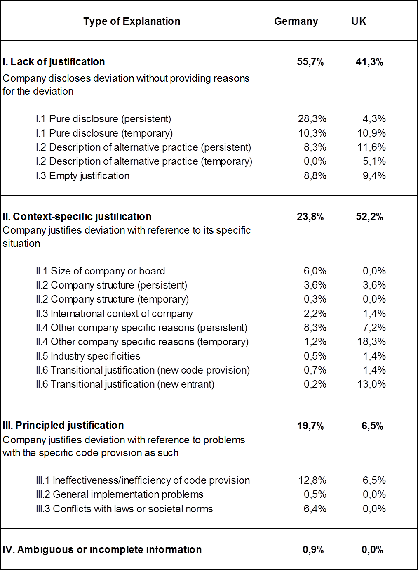

Slide 21
Summary
Overall code legitimacy was questioned more in Germany than UK:
“I am impressed by Mr Wiedeking. I like the way he resists complying with the rules. I do not think Mr Cromme (CG Code Commission chair) is completely honest. You just have to look at what happened with Volkswagen. There is no mention in the code that the board is not allowed to visit a brothel with the employees’ representatives!”(G)
Surprising? No - code (and comply-or-explain) drafted in the UK for UK capital market, UK ownership structures etc.
Criteria for success:
Soft law tradition
Regulatee buy-in (design/implementation/revisions)
Effective monitoring

Slide 22
Conclusions on comply-or-explain
Understanding the process by which a code works, to the point where it becomes unthinkable to act in any other way takes time (see Zucker 1991, Suchman 1995). In a culture where certainty is prized the concept of flexible regulation may be difficult to comprehend, for example where a regulatee’s actions and explanations are considered legitimate by one legitimacy-conferring group but not so by others.
In fact, faced with multiple monitors, it may be rational for regulatees to opt for hard law with its fixed rules in order to reduce uncertainty or, when faced with soft law, opt for full conformance.
Zucker, L. G. (1991). The role of institutionalization in cultural persistence. In W. W. Powell & P. J. DiMaggio (Eds.), The new institutionalism in organizational analysis (pp. 83-107). Chicago: University of Chicago Press.

Slide 23
Increasing uncertainty: flexible regulation in fast changing environments?
There is evidence that when conditions are uncertain regulatees converge towards full conformance in part to defend the legitimacy of the prevailing (and known) regulatory system (see Vainio 2011). And leaping from soft to hard law paradoxically also creates uncertainty – at least until enacted and embedded.
Arguably, the effect for accountability in CG of avoiding the uncertainty of explaining under comply-or-explain is that formal accountability may be enhanced while broader, informal, discursive accountability may be diminished.
Vainio, A. (2011). Why are Forest Owners Satisfied with Forest Policy Decisions? Legitimacy, Procedural Justice, and Perceived Uncertainty. Social Justice Research, 24(3), 239-254.

Slide 24
Something to be said for uncertainty?
Three distinct types emerged from earlier research - analysis of regulatory directors general perceptions of their accountabilities:
Instrumental approach: Certainty over formal accountability led to lack of engagement with accountability issues generally.
Ethical approach: Knowledge of own personal accountability, public service ethos evident but internalised, thus didn’t feel need to adopt a discursive enquiring approach to accountability. Not much discussed in their organisation.
Uncertain approach: Uncertainty, far from indicating lack of interest, was associated with much higher levels of engagement with issues of accountability than the other two groups – more discussions, more meetings to assess whether their organisation had accounted properly etc.

Slide 25
Some issues around accountability from previous work
From “Institutional investment & corporate accountability” project.
Institutional shareholders – owners or traders?
Mutual dependency but based in part on misunderstandings?)
perception investors focused on short term shareholder value but …
evidence of some investors’ demands for longer term forecasts (companies complicit in short-termism due to lack of confidence in forecasts)
Hendry, J., Sanderson, P., Barker, R., & Roberts, J. (2006). Owners or traders? Conceptualizations of institutional investors and their relationship with corporate managers. Human Relations, 59(8), 1101-1132.
Roberts, J., Sanderson, P., Barker, R., & Hendry, J. (2006). In the mirror of the market: The disciplinary effects of company/fund manager meetings. Accounting, Organizations and Society, 31(3), 277-294

Slide 26
Towards a conclusion
Link between good governance and performance uncertain →
Shareholder tend to focus (rationally?) on accountability only when interests threatened (e.g. share price fall) while other stakeholder interests arise as part of broader stakeholder (e.g. NGO) campaign →
Outcome oriented accountability: Mirrors broader society – means compliance failures used (rationally in respect of resources) to target sub-optimal outcomes rather than pockets of persistent sub-optimal practice (e.g. pharmacists) →
Not individualized or socializing but bilateral, contingent accountability (binding together but on an individual basis):
Companies: Less able to reliably forecast what will be accepted as compliant behaviour.
Stakeholders: Arguably less able to hold companies to account unless able to form coalition around specific understandings of what constitutes complaint behaviour.

